Slide 1
Assessment of Learning at COA
Institutional Effectiveness Committee
January 2011

Slide 2
Today’s Presentation and Activities
Review the ACCJC requirements on assessment
Review the SLOs
Identify assessment plans for all courses
Develop an Assessment Calendar
Establish deadlines and delegate responsibilities

Slide 3
ACCJC Requirements
Since 2007, the Accrediting Commission for Community and Junior Colleges (ACCJC) has clearly stated its expectation that colleges currently be at the "Continuous Sustainable Quality Improvement" level for Program Review and Planning on rubrics that ACCJC has provided.

Slide 4
ACCJC Requirements cont’d
Moreover, ACCJC has told colleges that they must be at the "Proficiency" level for student learning outcomes (SLOs) by end of Fall 2012.
What does "Proficiency" look like on the ACCJC Rubric?

Slide 5
8 characteristics quoted directly from the ACCJC rubric.
Student learning outcomes and authentic assessment are in place for courses, programs and degrees.
Results of assessment are being used for improvement and further alignment of institution-wide practices.

Slide 6
8 characteristics cont’d
There is widespread institutional dialogue about the results.
Decision-making includes dialogue on the results of assessment and is purposefully directed toward improving student learning.
Appropriate resources continue to be allocated and fine-tuned.

Slide 7
8 characteristics cont’d
Comprehensive assessment reports exist and are completed on a regular basis.
Course student learning outcomes are aligned with degree student learning outcomes.
Students demonstrate awareness of goals and purposes of courses and programs in which they are enrolled.

Slide 8
Are we at the Proficiency Level?
In examining each of these characteristics, where would we place our college? Our respective disciplines?
What would we need to do in order to achieve each of them?
How do these characteristics interact with the rubrics for program review and planning and institutional outcomes?
How can IEC help to achieve Proficiency?

Slide 9
Current Status
Percent of Course with SLOs: 58%
Percent of Programs with SLOs: 36 %
Percent of Courses with Ongoing Assessment:
3 %
Percent of Programs with Ongoing Assessment: 29 %
Percent of Student and Learning Services with SLOS: 53 %
Percent of Student and Learning Services with Ongoing Assessment: 26%

Slide 10
What is Assessment?
“It involves systematically gathering, analyzing, and interpreting evidence to determine how well performance matches those expectations and standards; and using the resulting information to document, explain, and improve performance.”
(Source: AAHE Bulletin, Thomas A. Angelo, 1995)

Slide 11
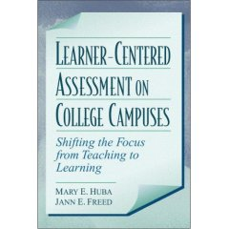
Another Definition of Assessment
Assessment is the process of gathering and discussing information from multiple and diverse sources in order to develop a deep understanding of what students know, understand, and can do with their knowledge as a result of their educational experiences; the process culminates when assessment results are used to improve subsequent learning. (p. 8) | Huba, M. E. & Freed, J. E. (2000). Learner-Centered Assessment on College Campuses - Shifting the Focus from Teaching to Learning. Boston: Allyn and Bacon.

Slide 12
Assessment Levels
Three types with different levels of focus:
Institutional assessment
Curricular and program assessment
Course and learner-centered assessments
Our focus for this session: Course and student learning support services.

Slide 13
Why We Assess
We assess to assist students in learning more.
We asses to decide when students are ready to advance.
And we assess to adjust our teaching and services to improve student learning.

Slide 14
Elements of an Assessment Plan
What assessment evidence will be collected?
When and how often will it be done?
Who will assess and reflect on the results?
How will results, implications, and related changes be documented?

Slide 15
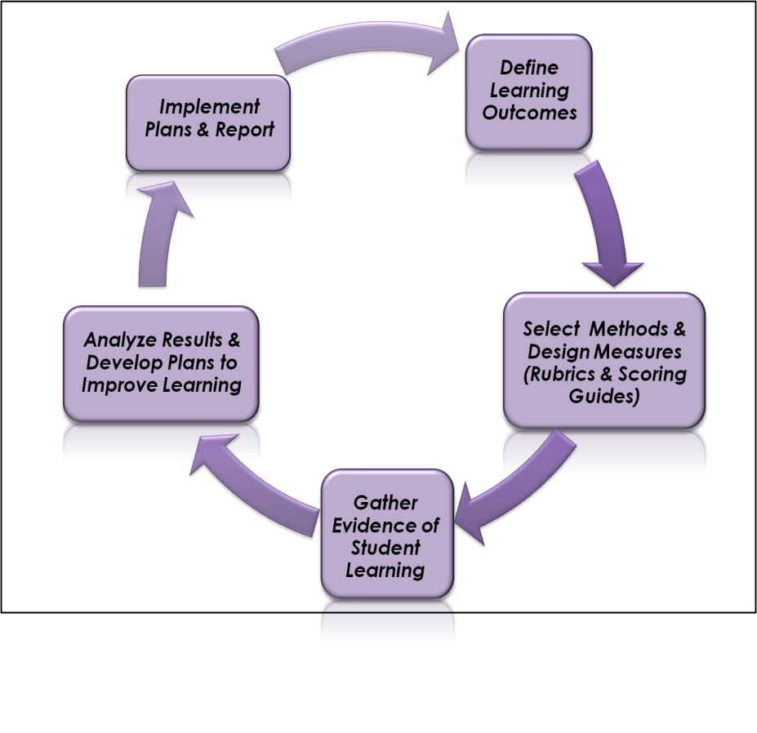
Closing the Assessment Loop: The Assessment Process from outcomes to quality improvement
James O. Nichols and Karen W. Nichols: A ROAD MAP FOR IMPROVEMENT OF STUDENT LEARNING AND SUPPORT SERVICES THROUGH ASSESSMENT

Slide 16
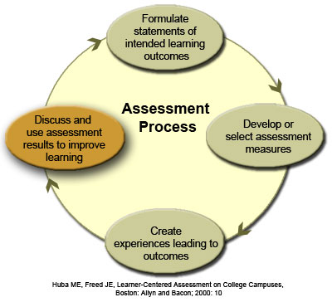
Learner Centered Assessment

Slide 17
Assessment Steps
Learning outcomes or learning intentions
What do we want students to know and be able to do as a result of this learning experience
Achievement criteria or success criteria
What will students need to do in (or out of) class to achieve the learning outcomes/learning intentions, and to what standard?
Context or task
What kind of learning experience will be appropriate to achieve the learning outcomes/learning intentions?

Slide 18
Two types of assessment methods
Direct measures
Students demonstrate their learning by doing something, such as responding to a test question or writing an essay.
Indirect measures
Ask for perceptions or opinions about learning from students or other self-assessment or assessment by others.

Slide 19
Assessment Methods
Direct Methods | Indirect Methods
Standardized tests Certificate exams Locally developed tests/test questions Rubrics for evaluating: Essays/Papers Labwork Exam questions Capstone projects Exhibits Performances/Presentations Portfolios of student work Comprehensive exams | Surveys Student Alumni Employer Exit interviews Focus groups Job placement rates Course evaluations

Slide 20
Suggestions
Focus on what you have been doing so well thus far.
Be aware that the assessment instruments should be valid and reliable interesting and meaningful to faculty and staff.
Include at least one direct method of assessment.

Slide 21
Suggestions
To improve reliability, use more than one assessment method per outcome.
Okay to sample students and to sample students’ work.
As needed, develop your own scoring rubrics for qualitative data student essays and reports, team projects, oral presentations

Slide 22
Take a few minutes...
When and where will the assessment take place?
Will you need to develop a scoring rubric?\
Will you use any sampling (of students, of student work)?
How will you motivate your students to do their best work on this assessment?

Slide 23
Take a few minutes
What is your plan for sharing the results with
faculty?
When will results be shared, and with whom?
Consider semester meetings
Include time to reflect on the results.
Keep track of recommendations for improvements and how they were implemented.
Report the aggregated findings in TaskStream by the end of the semester.

Slide 24
Program Review
The primary purpose of identifying and assessing learning outcomes at the program level is for program improvement.
Assessment at the program level is based on aggregated student performance data; it is not intended to give feedback to individual students.
Assessment is a faculty and classified professionals-owned and managed process.
Purpose is to provide feedback to us about how well they are meeting their program goals; not an administrative tool for making decisions regarding program cuts.
Documenting how we used assessment results to make program improvements is as important to ACCJC as the actual results of the assessment.

Slide 25
References
Angelo, T. (1995) Defining (and Re-assessing) Assessment: A Second Try, AAHE Bulletin no. 48,
Angelo, T., and Cross, P. (1993). Classroom Assessment Techniques A Handbook for College Teachers. San Francisco: Jossey-Bass.
Austin, at al. AAHE's 9 Principles of Good Practice for Assessing Student Learning http://www.apa.org/ed/governance/bea/assess.aspx#student-learning
Assessing Student Learning in Community Colleges, Janet Fulks (an online workbook -click the link at the left to access it). The direct URL is: http://online.bakersfieldcollege.edu/courseassessment/

Slide 26
References
Assessment Clear and Simple: A Practical Guide for Institutions, Departments, and General Education, Barbara E. Walvoord, Jossey-Bass, 2004.
Assessing Student Learning: A Common Sense Guide, Linda Suskie, Anker, 2004.
Assessing Academic Programs in Higher Education, Mary J. Allen, Anker, 2004.
Bloom, B. S. (Ed.) Taxonomy of Educational Objectives: THe Classification of Educational Goals. Handbook I: Cognitive Doman. White Plains, NY: Longman, 1956.
Gronlund, N. E. Measurement and Evaluation in Teaching. 4th ed. New York: Macmillan, 1981.

Slide 27
References – cont’d
Effective Grading: A Tool for Learning and Assessment, Barbara E. Walvoord and Virginia Johnson Anderson, Jossey-Bass, 1998.
Introduction to Rubrics: An Assessment Tool to Save Grading Time, Convey Effective Feedback, and Promote Student Learning, Danelle D. Stevens, Stylus, 2005.

