Slide 1
The Brain

Slide 2
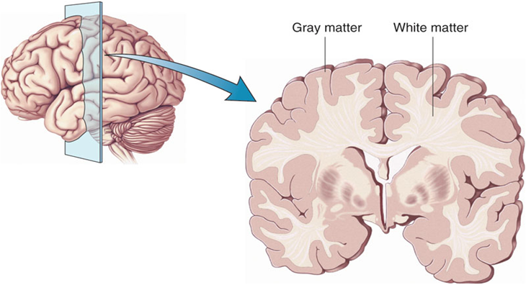
What is the cerebral cortex?
The cerebral cortex is the newest part of the brain (evolutionarily speaking)
It also consists of two main layers:
Gray matter
White matter

Slide 3
Gray matter
1.5-5 millimeters thick.
Rigid, wrinkled w/grooves -The wrinkly nature increases the total surface area and processing power. -If we were to flatten it out it would be approximately 2.5 square feet and could not fit in human skull.

Slide 4
Gray matter
In preserved brains, it has a gray color, hence the name “gray matter.”
Gray matter is made mostly of cell bodies, which gives it a pinkish gray color.
The interior of the cortex, where blood supply meets the brain, contains the cell bodies that do the work of the brain.

Slide 5
White Matter
White matter on the other hand is made up of myelinated axons that form the trillions of connections within the brain.

Slide 6
Two tips for remembering the cerebral cortex:
Tip 1: Orange Peel Analogy
Imagine the gray matter to be like an orange peel.
When you peel away the cortex, the remaining tissue looks white and shiny.

Slide 7
Two tips for remembering the cerebral cortex (con’t):
Tip 2: Think of gray matter as cities (and white matter as roads that connect the cities).

Slide 8
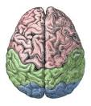
Now we are moving on to the division of the cerebral cortex
The cortex is divided into two hemispheres: Left and Right

Slide 9
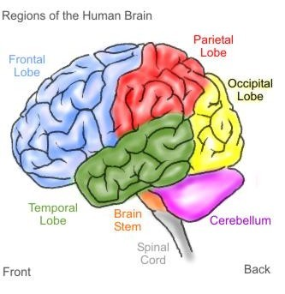
Four Lobes
Each hemisphere is divided into four lobes that have relatively specialized functions:
Temporal Lobe
Parietal Lobe
Frontal Lobe
Occipital Lobe

Slide 10
Each of the four lobes exists on the left and right hemispheres of the brain.
Each of the four lobes have boundaries created by deep grooves in the brain.
Each lobe also has:
-a primary cortex
-an association cortex

Slide 11
Primary Cortex
The primary cortex (motor or sensory) serves basic sensory and motor functions.

Slide 12
Association Cortex
An association cortex helps basic sensory and motor information from a specific lobe integrate with information from the rest of the brain.

Slide 13
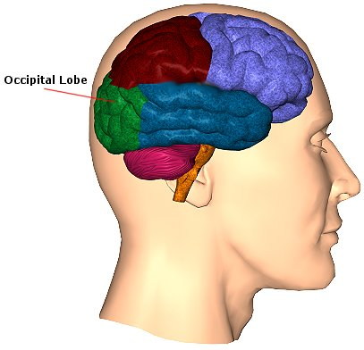
Occipital Lobes
The occipital lobe is:
The smallest of the four lobes.
Based on the location of the lobe, the part of your brain that is directly behind your eyes, they process visual information.
Try placing one hand at the very back and toward the base of your head; that is the occipital lobe.

Slide 14
Occipital Lobes
The occipital lobe’s primary visual cortex receives input from the eyes and translates that input into things we “see.”
The occipital lobe’s association cortex integrates the color, size, and movement of our visual perceptions so that visual stimuli become recognizable to us and shares this info with other brain regions.]
For example, it can send its results to the temporal lobe to find the stimulus’ name and to the parietal lobe to determine where it’s located in space.

Slide 15
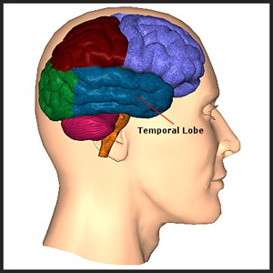
Temporal Lobes
The temporal lobes are located just in front of the occipital lobe. -They process auditory information
Seen in profile: human brain looks like a mitten; the temporal lobes are where the thumbs would be.

Slide 16
Temporal Lobe
The temporal lobes are home to the primary auditory cortex.
The association cortex surrounds the auditory cortex and is devoted to complicated task of understanding language.

Slide 17
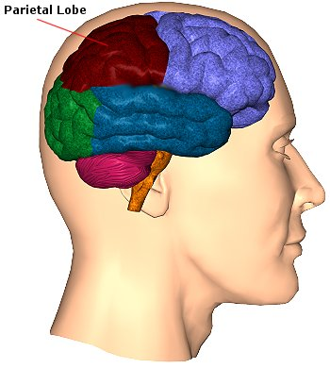
Parietal Lobe
Located above the occipital lobes, just behind the frontal lobes.
It includes the primary somatosensory cortex, which receives and interprets information about all of our bodily sensations.

Slide 18
Primary Somatosensory Cortex
We can think of this area of the parietal lobe as a homunculus or “little man.”
The homunculus is a distorted body man, with each part of the body sized according to how much space the brain gives to processing information about that body part.
For example, because so many neurons process information from the hands and lips, the homunculus’s hands and lips are remarkably oversized; while the area devoted to the hips do not take up much room (see picture on next pg.).

Slide 19
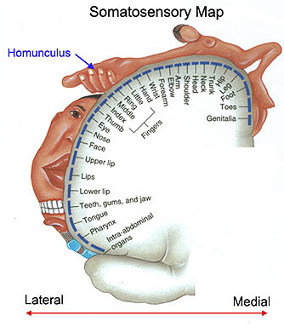

Slide 20
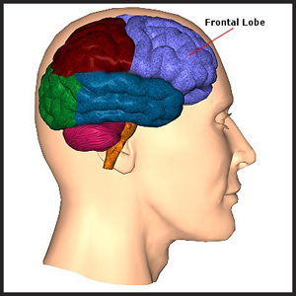
Frontal Lobe
Located behind your forehead; they are often referred to as the “executive” or “conductor” of the brain.
The frontal lobe performs a variety of integration and management functions.

Slide 21
Frontal Lobe
At the very back of the frontal lobes lies the primary motor cortex, which is responsible for voluntary muscle movement.
The association cortex helps integrate and orchestrate movement.
For example, the frontal lobe must work with the parietal lobe to make sure that movements are performed correctly within space.

Slide 22
The Divided Brain
A great number of brain functions, such as primary motor and association areas, are located in both the right and left cerebral hemispheres.
What is interesting about this symmetry is that the brain and body and crisscrossed.
For example, the motor cortex in the right side of the brain controls the movement of the left side of the body and vice versa.

Slide 23
Brain Hemispheres
Next we will be looking at the left and right hemispheres of the brain.
Connecting the two hemispheres is the corpus callosum (which is made of millions of axons – we can remember from the neuron lecture that axons send information, hence the corpus callosum sends information back and forth between both hemispheres of the brain).

Slide 24
Brain Hemispheres
It turns out that through research, scientists have discovered that each hemisphere, left and right, have particular functions, called hemispheric specialization, and work closely together.
Most of us take this coordination for granted because we have our corpus callosum in tack, so we often don’t notice huge discrepancies in functions.

Slide 25
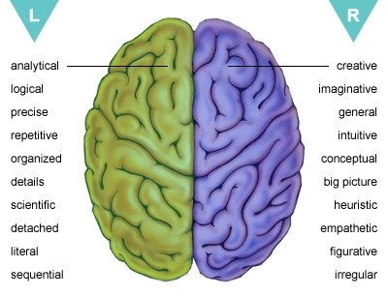
Brain Hemispheres
All of us, however, may have varying degrees of strength in one hemisphere of the brain over the other hemisphere.
Take a look at the diagram:

Slide 26
Brain Hemispheres
So, it turns out that the right hemisphere of the brain is known for perceiving the forest (big picture) and the left side of the brain is known for perceiving the trees (details).
Studies have found that in female brains, both hemispheres are more equally proportioned than in male brains that tend to have larger left hemispheres.
Which brain hemisphere do you think is larger in your brain?

