Slide 1
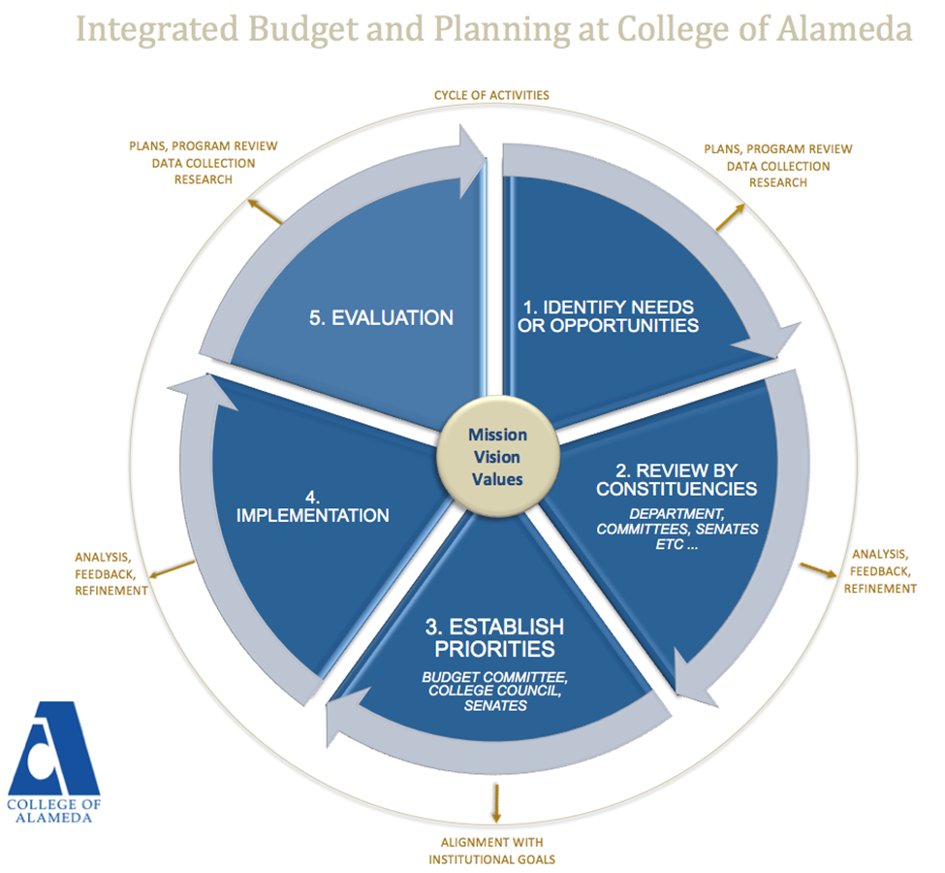

Slide 2
January - February
Review goals (and year-end metrics)
Review survey results
March - April
Refine strategies, actions and champions to enhance goal attainment in next academic year
College refines budget & submits to District
June
Peralta BOT approves goals and budgets for next academic year
August
Faculty review data & begin work on Program Reviews/APUs
October
Department requests due
Service areas (program/project managers) submit plans/needs
August - September
Research results and data provided to faculty, staff and administrators
Academic year strategic plan disseminated, champions and metrics identified
Identify Needs or Opportunities
Review by Constituencies
Establish Priorities
Implementation
Evaluation
November
Deans/managers prioritize & compile requests
December
COA participatory governance groups review requests
President forwards requests to District
July - June
Implementation of academic year plans
July - August
Research and data analysis conducted on previous academic year
Integrated Budget & Planning Cycle

