Slide 1
Guided Pathways Planning
Meeting #2
February 9, 2018
Noon -

Slide 2
Time | Agenda Items
12:00 – 12:15 p.m. | Lunch is served (with veggie options) Answers to last week’s questions presented over lunch
12:15 – 12:45 p.m. | Discussion of the Homework The Guided Pathways planning framework – 14 elements Reviewing the communications role Keeping the group’s recommendations in mind Plan priorities Organizing the work
12:45 – 1:30 p.m. | Group Work: CoA’s current strategic initiatives Translating the provided list of CoA’s strategic initiatives into a more cohesive framework Identifying areas with opportunity for leverage or deeper work
1:30 – 1:45 p.m. | BREAK
1:45 – 2:35 p.m. | Building a Guided Pathways framework unique to College of Alameda Redesigning Community Colleges – handout Generating ideas Organizing for a deeper dive next time
2:35 – 3:00 p.m. | Communications How will the group communicate with the larger COA community? Identifying 1-2 communications leads
3:00 p.m. | Close Next meeting: Thursday, February 15, 2018 Homework assignments

Slide 3
Questions from last time:
Q: Of the 61% of first-time students who are not taking transfer-level English in Year 1, how long does it take them to get to (and through) a transfer level course?
ENGL 201: 27% success rate over 2 years
English 201
ENGL 269: 4% success rate over 2 years
English 269

Slide 4
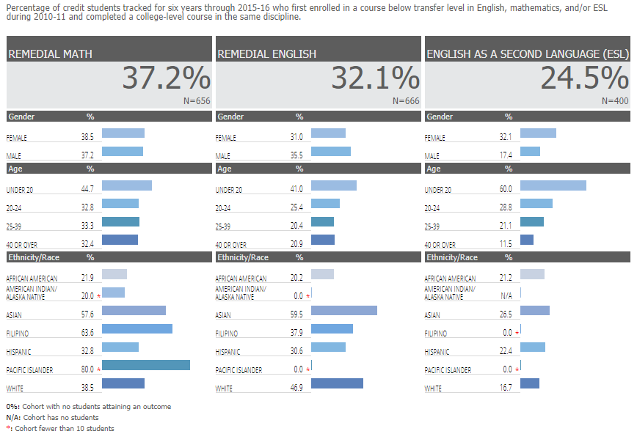
CoA Scorecard data

Slide 5
Questions from last time:
Q: Do we have 3-year transfer data? How many of our students transfer after 3 years by major?
A: Data issues – locally and as part of National Student Clearing House

Slide 6
Discussion of the Homework
Guided Pathways Plan Template – 14 elements
Recommendations
Draft plan priorities
How we organize the work
How we communicate the work – now and in the future

Slide 7
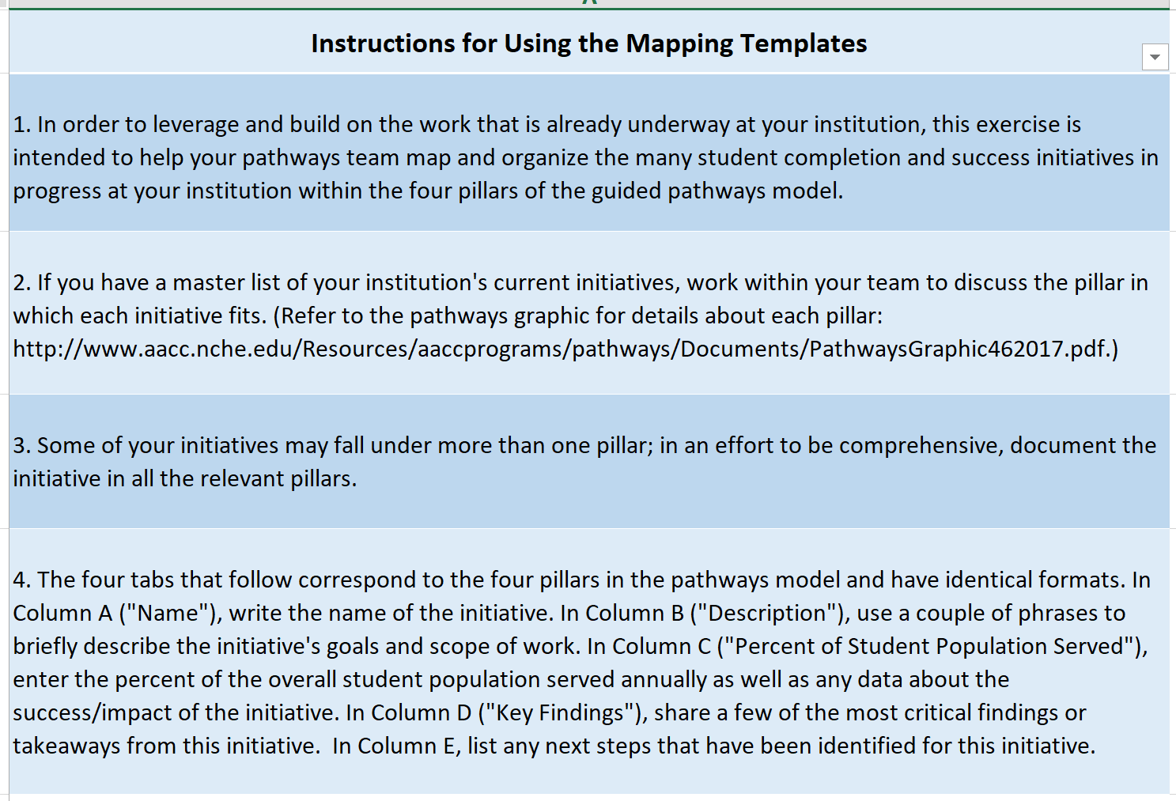
Using the Initiative Mapping Template

Slide 8
Designed for Access, Not Success
Too many choices, too little guidance
Paths to end goals unclear
Barriers to career advancement
Developmental dean-end
Students’ progress not monitored
Lost in the maze
Curricular incoherence hurts learning

Slide 9
Key features of the guided pathways model:
Degree maps
Exploratory or “meta majors”
Predictable schedules
Integrated instruction in foundation skills
Progress tracking, feedback and support
Bridges to college programs

Slide 10
Design principles
Help students with career exploration and goal-setting from the start
Require every student to have a clear roadmap to completion, further education and job advancement.
Ensure that program learning goals are clearly articulated and are aligned with requirements for success in further education and employment (engaging employers and university colleagues to do so).
Simplify choices for students, using program maps as the defaults for program plans that are required of every student but that students can customize with support from an advisor.
Give students predictable course schedules that make it easier to organize their lives around school and graduate on-time.
Redesign the new student intake process to help entering students who are undecided about a major to choose a field of study as quickly as possible.
Integrate teaching of foundation skills into college-level gatekeeper courses for major program areas to enable academically unprepared students to successfully enter a program of study as soon as possible.6
Monitor student progress on their program plans, providing frequent feedback and support as needed.
Build bridges into college programs (as opposed to preparing students for college generally) from high schools, adult basic education and other feeders.

Slide 11
Start with the end in mind: map student pathways to end goals
The first step in creating guided pathways is to engage the faculty, with input from advisors, in mapping out programs. Program maps should:
Describe in detail the further education and employment outcomes the program is designed to prepare students for—if further education is needed to enter career-path employment in a given field, indicate that as well.
Include clear learning outcomes that are aligned with the requirements for success in the next level of education and career advancement.
Specify default sequence of courses to ensure that students are building skills across the curriculum.
Identify “critical courses” that are highly correlated with success in a particular field and that students must pass to be allowed to proceed in that major.
Require students who have not decided on a specific major to choose an exploratory major.
Include academic and non-academic milestones by term for the entire program that students are expected to achieve to ensure timely program completion.
Simplifying and clarifying program pathways requires complementary changes to other college practices, particularly in how the college approaches instruction, students support services, and the new student intake process. The program pathway maps provide a framework for faculty and staff to worktogether to redesign these other key college functions to support student learning and success.

Slide 12
Engaging faculty and staff in the process

Slide 13
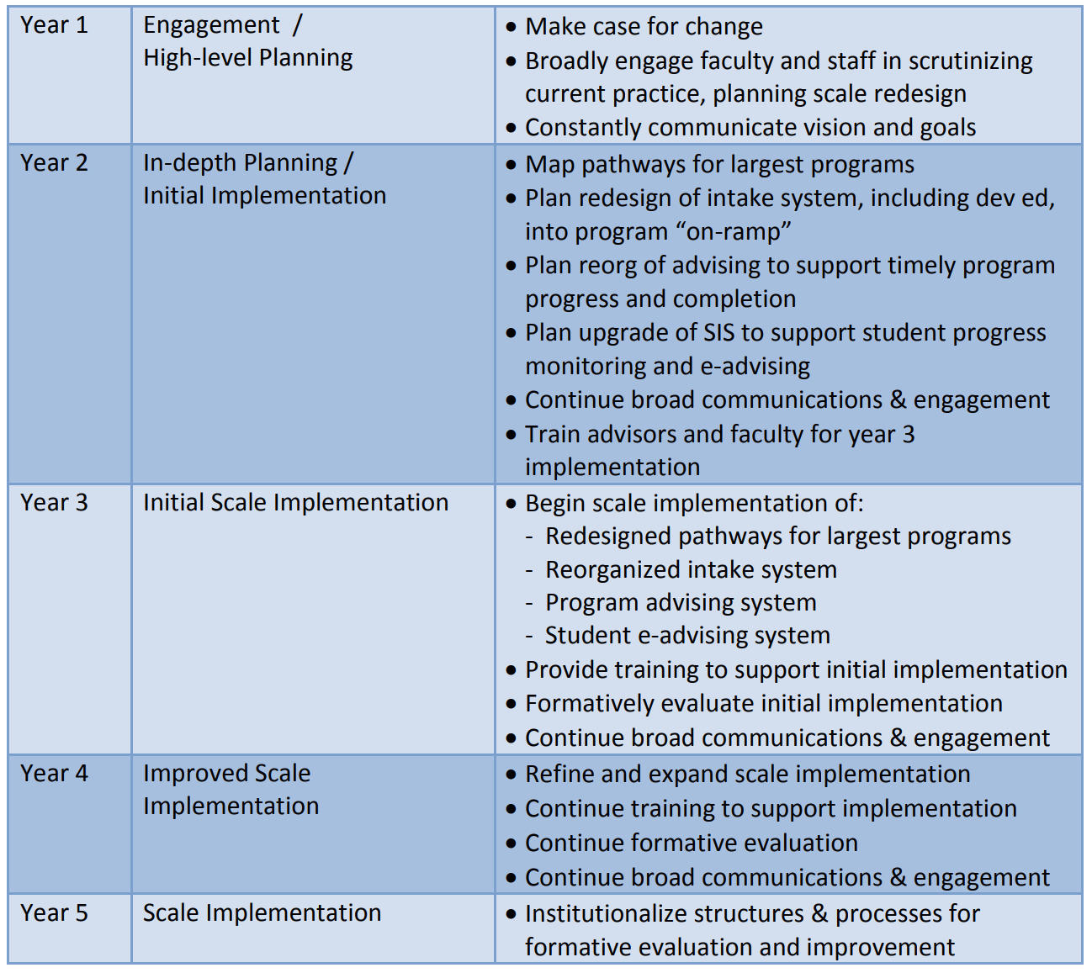
Hypothetical Timeline

Slide 14
Next steps and homework for next time
Communications
Thursday, February 15, 2:30 – 5:30 p.m.

