Slide 1
Accreditation Update
COLLEGE of Alameda
Fall 2014

Slide 2
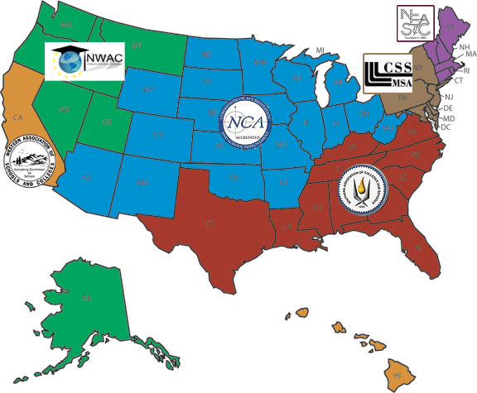
Regional Accrediting Agencies

Slide 3
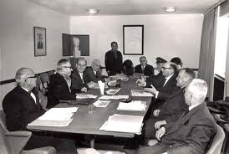
ACCJC Commission
Commission Membership
5 faculty from member institutions
3 administrators from member institutions
1 member from a Pacific Islands member institution
1 member from a private member institution
1 member from California CC System
1 member from Hawaii CC System
1 member from ACSCU and 1 from ACS
5 public members

Slide 4
Why, Who, How
Peer review is at the heart of accreditation, including the periodic review and revision of the Standards
“We” do – the member institutions through representation on a regional accrediting commission
http://youtu.be/Y8oDnUga0JU?t=1m6s
The Standards are:
Mutually Agreed Upon, Shared Expectations Based Upon Best Professional Practices
External Requirements From Governmental Agencies
Assure Quality of Institution Along Multiple Domains

Slide 5
Timeline
August 2014: 1st Community Review and continuing revisions
September 2015: 2nd Community Review and final editing
October 2014: Self-Evaluation Document Completed
November 2014: 1st read of Self-Evaluation by Board of Trustees
December 2014: Approval of Self-Evaluation by Board of Trustees
January 2015: Self Evaluation received from printers
March 2015: Site Visit

Slide 6
Where We Are
Steering Committee has met weekly over summer
Standards Draft (80% completed)
Organizational Charts (completed)
Eligibility Requirements Draft (completed)
Compliance to Commission Policies Draft (completed)
Response to Previous Recommendations (in progress)
Service Area Data & Student Demographics/Achievement Draft (in progress)
Narrative History of College Draft (in progress)

Slide 7
Focused Participation & Feedback
August to October 2014
Provide feedback to draft standards
Participation on standard-teams still needed
Standard IIIA
Standard IIIC
Standard IIID
Standard IVA

Slide 8
Feedback Steps
Go to Accreditation webpage
http://alameda.peralta.edu/accreditation/
Read Standards
Click on the feedback form for related Standard
https://www.surveymonkey.com/s/NFHJY67
Provide comments, suggestions, location of evidence, etc…

Slide 9
Planning Team
ACCREDITATION LIAISON OFFICER : Tim Karas
STEERING COMMITTEE CHAIR : Dr. Alexis Montevirgen
ACCREDITATION FACULTY CO-CHAIR : Drew Burgess; Glen Pearson
ACCREDITATION CLASSIFIED CO-CHAIR : Caitlin Fischer
STEERING COMMITTEE MEMBERS-
Interim President: Dr. Eric Gravenberg
Academic Senate President: Trulie Thompson
Classified Senate President: Brenda Lewis
ASCOA President: Alaysia Williams

Slide 10
Mission Statement
The Mission of College of Alameda to serve the educational needs of its diverse community by providing comprehensive and flexible programs and resources that empower students to achieve their goals.

Slide 11
Vision
The Vision of College of Alameda is that we are a diverse, supportive, empowering learning community for seekers of knowledge. We are committed to providing a creative, ethical and inclusive environment in which students develop their abilities as thinkers, workers and citizens of the world.

Slide 12
Values
We use this vision to choreograph three central themes in our quest for “learning excellence” and services to students.
Academic Excellence
Budgetary Competence, and
Community Engagement
We call these “our ABCs” emphasizing crucial success indicators for our students in achieving an enhanced capacity to pursue their dreams!

Slide 13
Institutional Set Standards
Effective Spring 2013
Higher Education Opportunities Act 2008; United States Department of Education Guidelines 34 C.F.R 602.16(a)(1)(i), January 2012
“Standards effectively address success with respect to student achievement…and the institution’s performance with respect to student achievement is assessed.”

Slide 14
COA Initial Set Standards
Spring 2012
Course Completion (percentage of students who successfully complete a course) 67%
Fall 2013 68.4%
Student Retention (Percentage of students who are retained fall to Fall) 54%
FALL 2012 49.4% (63.6% FT/ 47.5%PT)
FY14/15: Dialog leading to consensus benchmarks

Slide 15
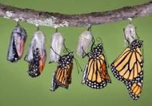
Substantive Change
Addition of a Program or Courses that Represents a Significant Departure from an Institution’s Current Programs or Curriculum
A program offered in face-to-face format is now offered 100% online.
Addition of a New Degree or Career Technical Education Certificate Program that Represents a Significant Departure from an Institution’s Current Programs
An institution develops a new degree or career technical education certificate program to be offered at the main campus or at any one of the approved institutional sites off campus.
Addition of Courses that Constitute 50% or More of the Units in a Program Offered through a Mode of Distance or Electronic Delivery, or Correspondence Education
An institution offers courses that make up 50% or more of the credits required for a program through an instructional delivery that is new for the college or the program.

Slide 16
Questions?
Contact Me-
Tim Karas
Vice President of Instruction
tkaras@peralta.edu

