Slide 1
Speak Easy: Student Speech Presentations Made Easy
Jennifer Fowler: jfowler@peralta.edu
College of Alameda Distance Education Coordinator

Slide 2
3-Step Process
Step 1
Set expectations with students.
Step 2
Create a sign-up list.
Step 3
Conduct presentations on Zoom.

Slide 3
STEP 1: Set expectations
Tell students as early as possible and be explicit about the process.
How will they sign up? Will you record the speeches? Will you allow makeups?
Let them know they need a webcam and microphone or a smart phone.
Do a Zoom test-run before the assignment.
Post about the assignment and refer to it in multiple places.
Canvas announcement, page, modules, a video, the syllabus, email, etc.

Slide 4
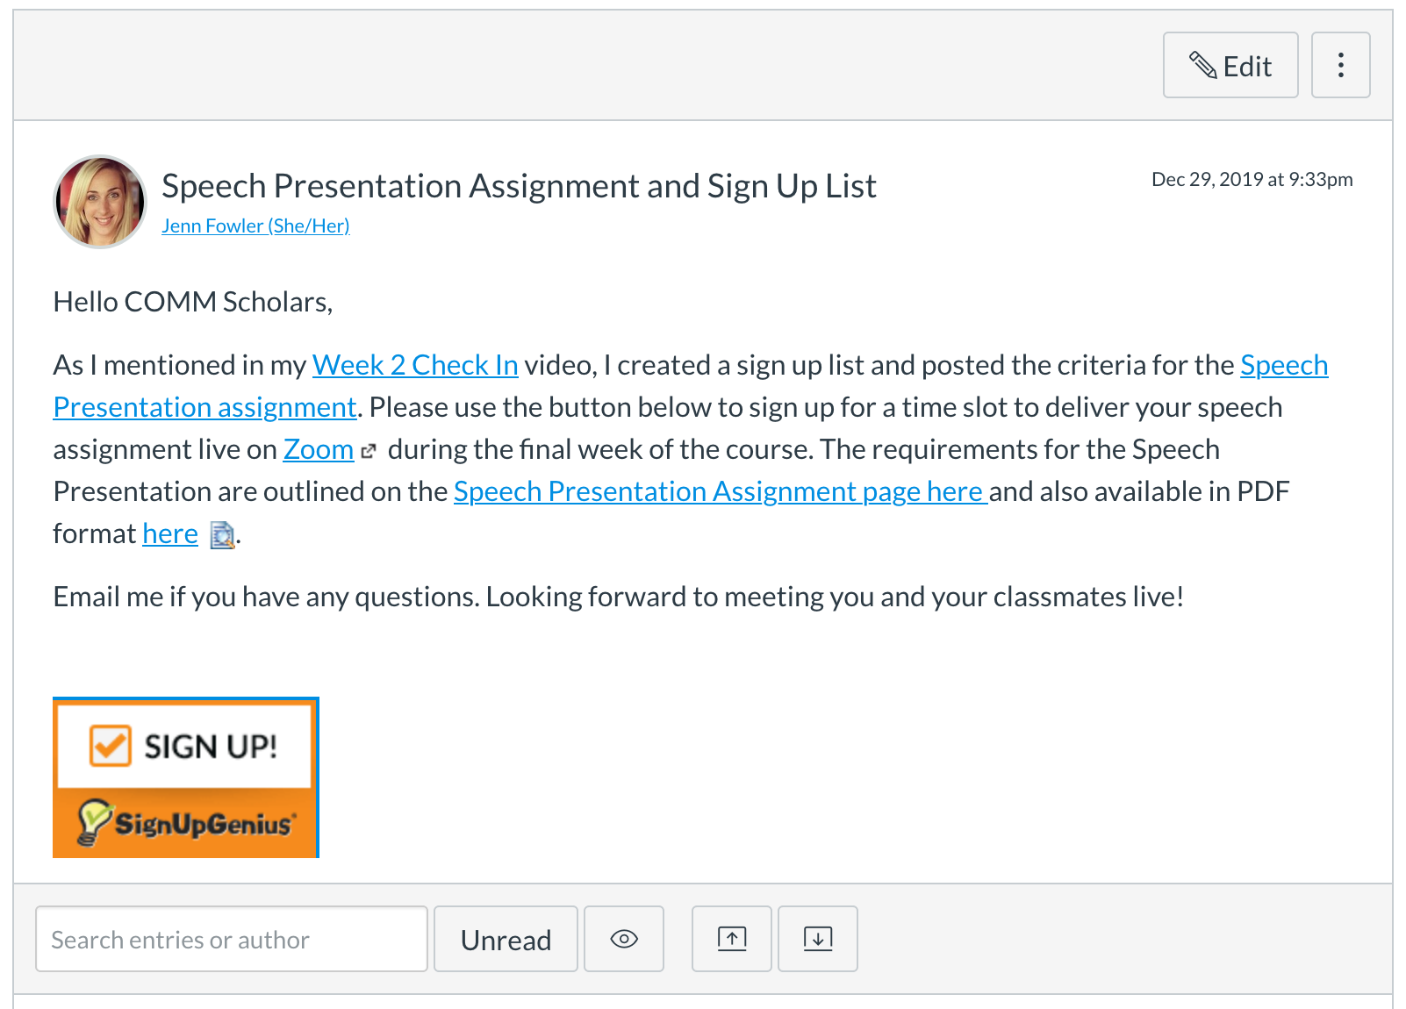

Slide 5
STEP 2: Create a sign-up list
Depending on class size, set aside a few days/times in a single week or series of weeks for speeches.
Hold meetings on different days of the week and times.
Use Google docs, Microsoft OneDrive, or SignUpGenius.com for students to reserve a time slot.
Consider closing the document for edits after a certain point. Ask students to email you if they need to reschedule the original date.
On average, around 5-6 speeches in a single session is ideal.
Build in a makeup day, whether you tell the students the date or not.
Put the link to your Zoom room everywhere. In the sign-up sheet, the assignment details on Canvas, an announcement in Canvas, etc.

Slide 6
STEP 3: Conduct Presentations on Zoom
Arrive early to the meeting to help students get setup. Have students test their mic and webcam before presentations begin.
Ask students to mute themselves when not speaking to cut down on background noise.
Don’t forget to hit record.
It’s ideal to record the meeting so you have a record of the students completing the assignment.
On average there’s usually one student per session that does not show up.
Go easy on video quality. Lower expectations. There is beauty in the informality of the medium.

