Slide 1
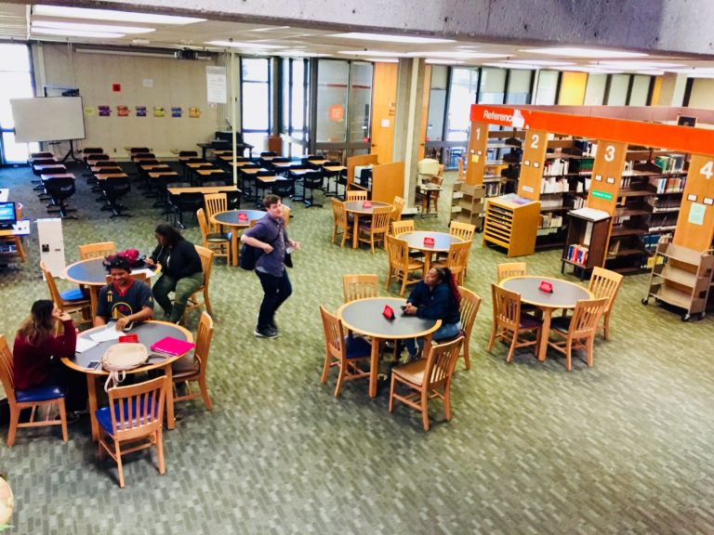
Librarian: Mary Poeck mpoeck@peralta.edu Hours: Wed. & Thursday, 8am-4pm
WELCOME TO COA LIBRARY!
ULREY - English 5, Summer 2020
LIBRARY ORIENTATION
Session 1:
Library Resources Choosing a topic
Finding & evaluating sources

Slide 2
OBJECTIVES/OUTCOMES:
Understand the welcoming and useful aspects of the library.
Able to share information about the resources available in the library and how to use them.
Understand how to choose a topic and refine it using the writing process and the Information Literacy Framework.
Understand the Information Literacy Process and be able to use it in real life situations. (You actually did this in your assignment in Module 2 Unit 3 – your Fact Finding Report).
Understand how to evaluate information for accuracy and credibility.
Able to use search skills for locating valid sources of information for your research paper
Understand different sources of information and when and how they can be used.

Slide 3
NEED LIBRARY ASSISTANCE?
https://alameda.peralta.edu/library
Library Service Hours Summer:(Online only)
ONLINE ONLY:
“Chat With a Librarian” = live chat
“Ask a CoA Librarian” = email
now through July 23, 2020:
Mon. – Thurs.: 8:00 am – 4:00 pm

Slide 4
What can I find in the library?
Study Rooms – Request at the reserve desk; quiet study room in L115
Textbooks – Can be checked out at the Reserve desk
Computer lab and printing – on the 2nd floor
Reference Help – Need help finding articles, books, or doing research? Ask a librarian (Live Chat or email)
Learning Resource Center – One-on-one tutoring, math and English labs (see link in your Canvas Course)

Slide 5
LIBRARY RESOURCES & SERVICES
Books - Circulation, Reference, Reserves
Circulating Books
Books you can check out for 3 weeks!
Fiction and Non-Fiction mixed together
Best Sellers - New Books - Easy Readers -
“Book Stacks”
Image

Slide 6
LET’S GO TO THE LIBRARY WEBSITE TO EXPLORE OTHER RESOURCES:
https://alameda.peralta.edu/library/
When you are there here are the handouts to download:
MLA Handout https://alameda.peralta.edu/amy-stewart-deaker/
Evaluation of Sources
Scholarly vs Popular Magazines
Off Campus Access to Library Databases
REMEMBER TO REVIEW THE LIBRARY WEBSITE – IT IS FULL OF USEFUL RESEARCH INFORMATION!

Slide 8
CRITICAL THINKING SKILLS CURRICULUM
How do I apply them to real life? You’ve learned about the importance of
Observing and seeing
Pre-judgments and how they affect what we see & believe
Biases in people, organizations and news media
Stereotypes anD how they help us define the world
Viewpoints – how race, gender, religion, culture, occupation, etc. g influence our view of the world
Generalizations make it easy to be a lazy thinker– Californians vs. texans
Awareness and self observation are essential skills when learning to think critically and write effectively!

Slide 9
What is Research and how do I do it? Multistep process similar to: writing process, decision making process, scientific method

Slide 10
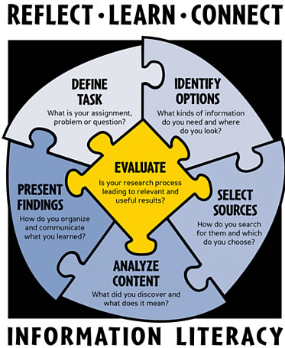
Suffering from Information Overload?
Information literacy is knowing:
When
Why
How
to use different types of information sources
to pick the best sources for your needs
Information Literacy at Grays Harbor College by the John Spellman Library is licensed under a Creative Commons Attribution-NonCommercial-ShareAlike 3.0 Unported License. Based on a work at Seattle Central Community College Library. Used with permission

Slide 11
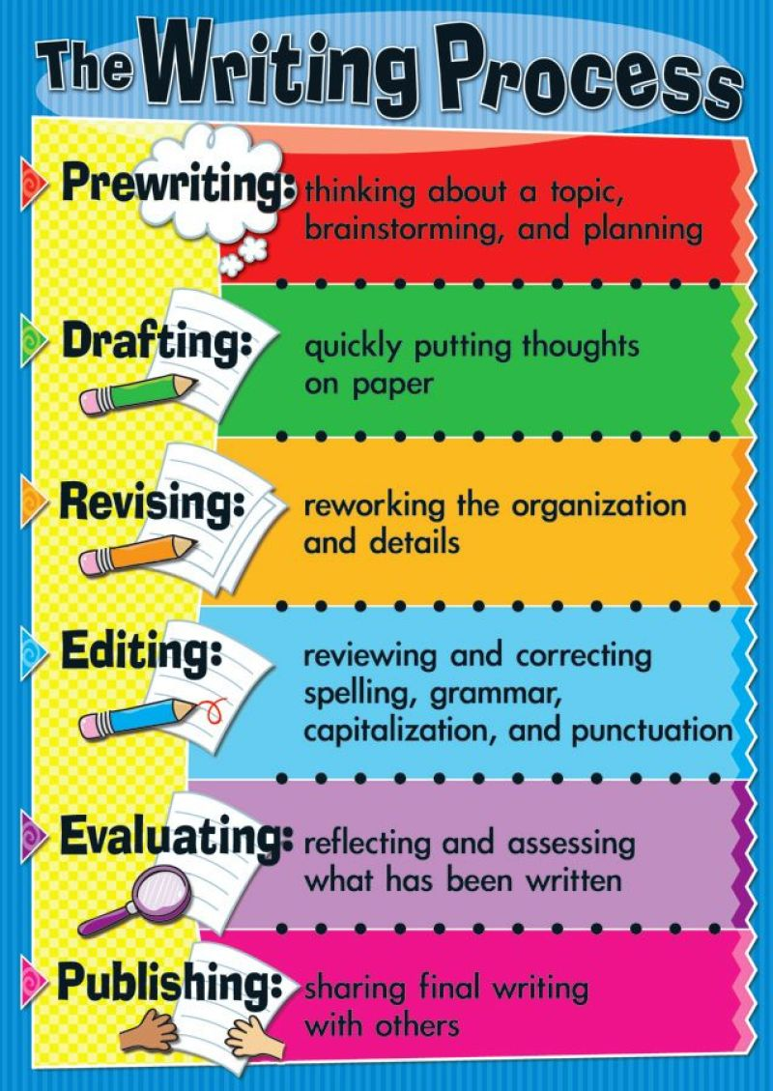
THE WRITING PROCESS
EXPLORING IDEAS:
SUBJECT
PURPOSE – INFORM, PERSUADE, ENTERTAIN
AUDIENCE
PREWRITING –
BRAINSTORM
CLUSTER
FREE WRITING
QUESTIONING (THE 5 W’S)
ORGANIZING – OUTLINING
1ST DRAFT
REVISE
REVIEW
ADD INFORMATION
REARRANGE SENTENCES/PARAGRAPHS
READ ALOUD – DOES IT MAKE SENSE?
FINAL COPY
EDIT
PROOT READ FOR CONTENT, CRITICAL THINKING AND CONTENT. DID YOU FULFILL YOUR PURPOSE.
KEEP IT IN MIND AS YOU WORK

Slide 12
TIME TO APPLY WHAT WE’VE LEARNED:
RESEARCH PAPER ASSIGNMENT:
Instructions:
Choose a current, controversial topic
Have a full understanding of the topic
Have a definitive position on it
Write a clear, argument essay using research to support your argument.

Slide 13
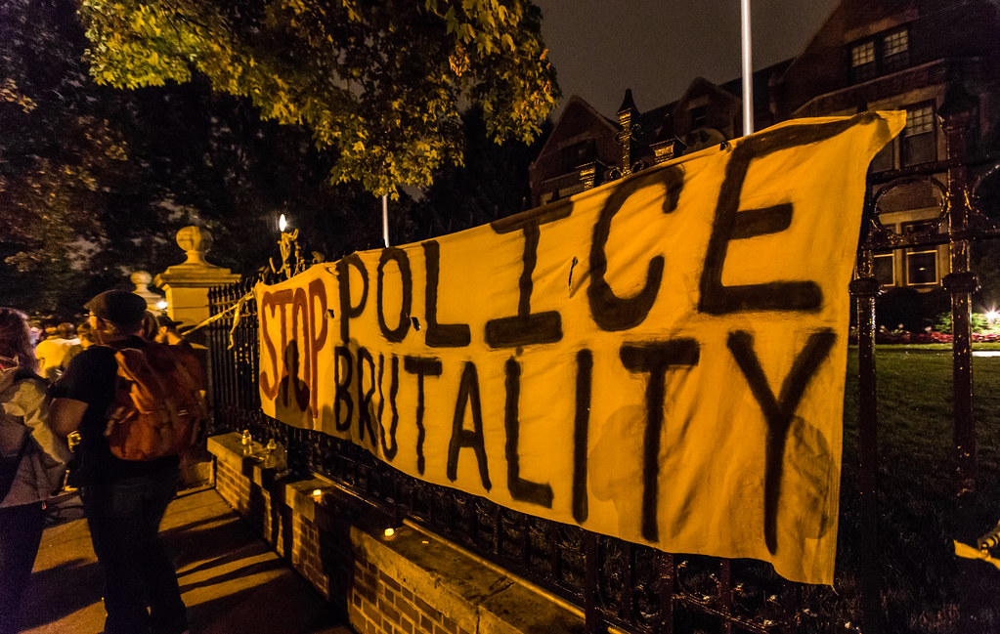
Some ideas for topics
Police Brutality
Gun Control
Global Warming
Immigration
Death Penalty
COVID-19

Slide 14
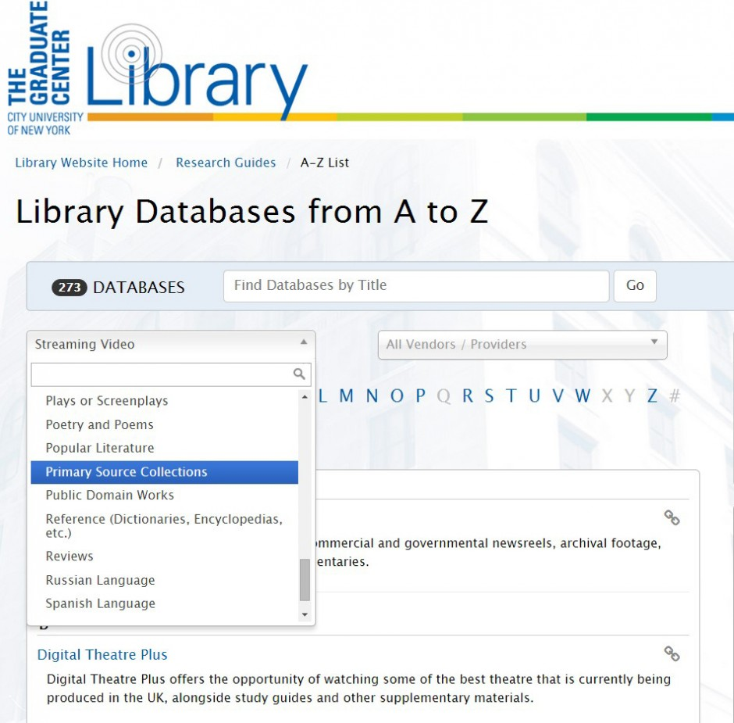
Gain a general overview of your subject
Begin research -- look at various sources to see what is out there

Slide 15
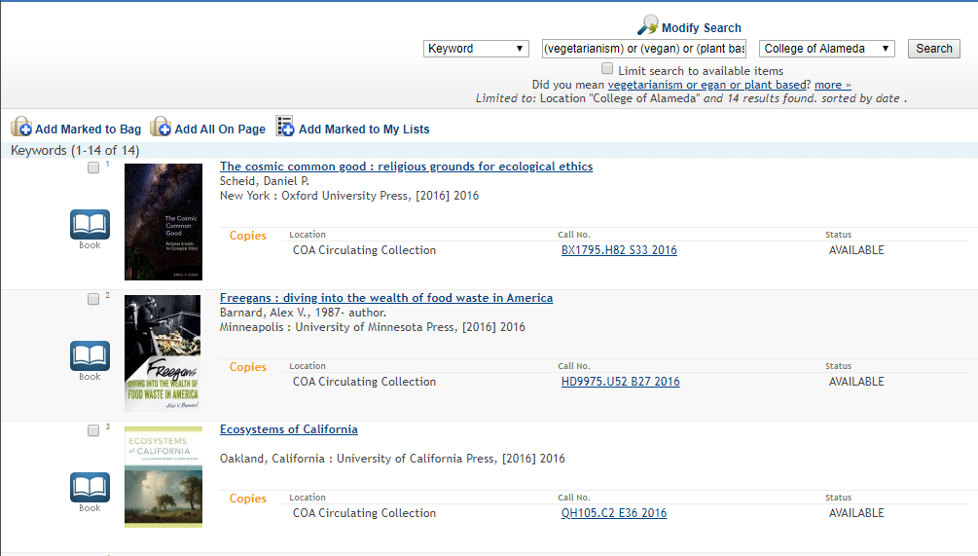
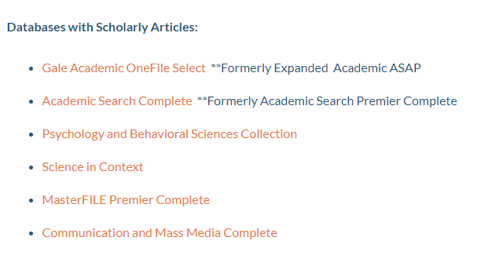
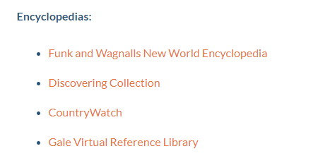
Credible sources: What are they and where to find them?
Scholarly books and reference books
The COA library catalog
Scholarly and encyclopedia articles?
COA library databases
Notes:
Talk about the research process (5 minutes)
- Selecting a topic, narrowing it down, using boolean, doing the search, repeating if necessary
Have them do a search for scholarly articles on immigration (10 minutes)

Slide 16
Credible sources continued
Reliable websites?
.gov, .edu, some .org URLS
census.gov
berkeley.edu
pewresearch.org
Reliable newspaper articles?
Big city newspapers: LA Times, SF Chronicle, New York Times
Films and short stories?
Kanopy and COA ebooks
Notes:
Talk about the research process (5 minutes)
- Selecting a topic, narrowing it down, using boolean, doing the search, repeating if necessary
Have them do a search for scholarly articles on immigration (10 minutes)

Slide 17
WHY USE LIBRARY DATABASES INSTEAD OF THE INTERNET?
Written by experts in the field of study
Experts have credentials that qualify them to write and PEER REVIEW other articles in the same field.
They are reliable – no need to evaluate them.
They provide many features that help to narrow or broaden topics, citations for articles, email and print access, depending on your location.
Some of them read the text while highlighting it and provide dictionary help!

Slide 18
Websites: The "CRAAP" Test
Currency
When was it published? Does your topic require more current information?
Do the links still work?
Relevance
Does the information fit in with the argument you're trying to make?
Who do you think the source was written for?
Authority
Is the author qualified to write on the topic? Would they have a reason to be bias?
Pay attention to the URL: .gov and .edu websites are the most reliable. You should be more careful with .com, .net. and even .org websites
Accuracy
Is the information given supported by evidence (cited?)
Does the language seem professional, or is it full of emotion?
Purpose
What is the purpose of the information? Is it to inform, sell, entertain or persuade?
Is the information fact, opinion or propaganda?
Notes:
Talk about the research process (5 minutes)
- Selecting a topic, narrowing it down, using boolean, doing the search, repeating if necessary
Have them do a search for scholarly articles on immigration (10 minutes)

Slide 19
Choose your topic – task definition
Something that interests you, That you have an opinion on
Browse textbook, lecture notes, magazines, and newspapers for ideas -- brainstorm
Look at databases that may help. https://alameda.peralta.edu/library/article-databases/
Remember choosing your topic is RESEARCH!
(view video https://www.lib.ncsu.edu/tutorials/picking_topic
Ask your instructor or a librarian for help

Slide 20
Narrow and shape subject into specific questions or statement
Use the databases for ideas about focusing or narrowing your topic
Example – Gun Control – Main concept but too Broad
What do you want to know about Gun Control?
2nd amendment
Automatic weapons
Number of gun related deaths (limit to USA)
NRA
School violence
Mass shooting
How many people die from gun violence?
How does the 2nd amendment justify automatic weapons?
Why is the NRA so fearful about common sense gun control?

Slide 21
Main Concepts of Question when defining your topic
What is the effect of _____ on ____ ?
What is the role of _____ on ____?
How has the use of ____ affected ___?
Why has ___ led to ____?

Slide 22
Learn various types of searching to help focus your topic

Slide 23
Developed by Amy Stewart-Deaker

Slide 24
Developed by Amy Stewart-Deaker

Slide 25
Developed by Amy Stewart-Deaker

Slide 26
Developed by Amy Stewart-Deaker

Slide 27
Let’s take a look at the databases and see how they work to help you with your searching:
The all have similar features, but they could be located in various places – besure to explore and use those “observation” skills you have been working with. We’ll look at three databases again:
Opposing View Points
Sirs Issues Researcher
Academic Search Complete
We’ll also look at e-books and Films on Demand

Slide 28
Review what we’ve covered any questions? NEXT WEDNESDAY – SESSION 2 – July 8, 10 am & 6 pm Plagiarism, citations & annotated bibliographies

Slide 29
Thanks!
Any questions?
HAPPY 4TH OF JULY!
Mary Poeck
You can find me at:
mpoeck@peralta.edu

