Slide 1
LSLA DIVISION MEETING - Liberal Studies and Language Arts (LSLA)
Presented by Dean Lilia Celhay
March 6, 2020

Slide 2
AGENDA
Welcome
Notable Achievements
Progress on Division Goals
Corona Virus Safety
Division Website Resources
SLOs: Stipend, and Inclusion in Syllabi
FTEF Reduction for 2020-2021 (summer and fall 2020 and spring 2021)
Questions?
Notes:
Now, that you have narrowed your topic, you will want to organize your research in a structure that works. There are some common organizational patterns based on the kind of research you are doing.
Organizational Structures:
Cause and Effect- this kind of structure is great for explaining the causes and effects of a topic
Compare and Contrast- in this pattern you highlight the similarities and differences of the topic
Explain process- this structure is great for outlining a series of steps to follow;
Definition- if you want to make sure your audience understands what something is using illustrations, meanings, clarifying misconceptions, you may want to use this structure
Classification- a common organizational structure is grouping like topics or facts from the research together. For instance, in the internet safety about social media apps, you may organize the research where you look at each social media app one at a time

Slide 3
NOTABLE ACHIEVEMENTS 2019-2020
English AB705: The English Department is completing its first year of implementing the AB705 mandate in fall 2019.
ESOL AB705: The ESOL Department is working on developing curricula and onboarding strategies to meet the AB705 mandate, starting in fall 2020.
Hispanic-Serving Institutions (HSI) Grant: Grant was awarded in September 2019. Currently working on hiring three full-time positions.
Guided Pathways: Maps for ADTs have been completed.
Equity Academy: A group of 30 faculty, classified professionals, and administrators attended The Anatomy of a Transformative Course: Critical Competencies for Student Success in November 2019.

Slide 4
DIVISION GOALS
ACADEMIC YEAR
2018 - 2019
ACADEMIC YEAR
2019 - 2020
Improve communication
Use technology to advance our work
Improve collaboration
Improve enrollment planning
Advance goals from previous year
Increase submission of rosters on time
Increase professional development opportunities
Identify alternative funding (Dean)

Slide 5
Corona Virus Safety Tips
Wipe down shared surfaces regularly with wipes containing 10% bleach or 90% alcohol
Wash your own hands and keep them away from your mouth, nose and eyes (these mucus membranes communicate with each other)
Post handwashing signs in MANY places
Have a scarf you can pull up over your nose and mouth in case you find yourself in “tight” quarters
Stay home if you feel a fever coming on, develop a cough, or have shortness of breath. These are the 3 signs of the Corona Virus.
For more information, please visit Centers for Disease Control and Prevention https://www.cdc.gov/coronavirus/2019-ncov/index.html

Slide 6
USING TECHNOLOGY TO ADVANCE OUR WORK
Canvas
Websites
OneDrive and SharePoint
This Photo by Unknown author is licensed under CC BY-NC-ND.

Slide 7
DIVISION WEBSITE
Forms
Procedures
Important dates
Your thoughts and requests?

Slide 8
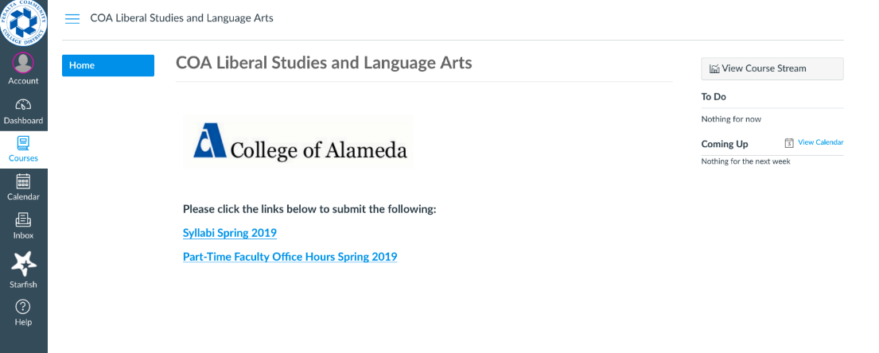
SLOs in Syllabi, Canvas Shells and Accreditation
ACCJC Standard II A. 3
The institution identifies and regularly assesses learning outcomes for courses, programs, certificates and degrees using established institutional procedures. The institution has officially approved current course outlines that include student learning outcomes. In every class section students receive a course syllabus that includes learning outcomes from the institution’s officially approved course outline.
Notes:
Thank you for your patience through the pilot run. We have learned a lot. This practice has saved much time. Future use. . . .

Slide 9
SLO Stipend
SLO data/information entry into CurriQunet
$100 per course for part-time faculty up to $300
SLOACs are ready, willing and able to help
For more information, please contact:
Frank Nguyen Le
Amanda Price, LSLA SLOAC

Slide 10
FTEF Reduction and Scheduling
District: Refer to email from VC Siri Brown on Dec. 10, 2019
Department Chairs Meetings: January 24 and 31, 2019
Development of discipline plans based on reduced allocation: February and March 2020
Schedules for summer and fall 2020 in progress
Notes:
We are embarking on a new paradigm that focuses on convergence on student completion.
The statewide initiatives are a game changer. As we look at our personal work, we must view it through these statewide initiatives.

Slide 11
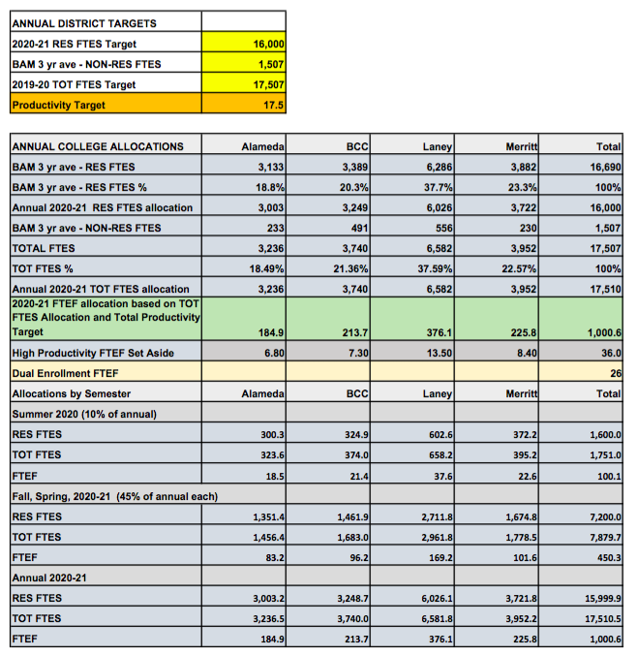
COLLEGE OF ALAMEDA FTEF for 2020-2021: 184.9
For comparison:
2016-2017: 222.6
2017-2018: 224.1
2018-2019: 213.6
Difference from 2019-2020 to 2020-2021= -35.2

Slide 12
FTEF Reduction Current Exceptions
Dual Enrollment
Online intersessions (spring and fall)
Contract education
Fee-based courses
Grant-funded courses

Slide 13
Strategies to Reverse Enrollment Trend
Improve enrollment management
College of Alameda
Districtwide
Increase enrollment
Increase retention
Improve completion

Slide 14
QUESTIONS?
Thank you!
Notes:
You can use this slide as your opening or closing slide. Should you choose to use it as a closing, make sure you review the main points of your presentation. One creative way to do that is by adding animations to the various graphics on a slide. This slide has 4 different graphics, and, when you view the slideshow, you will see that you can click to reveal the next graphic. Similarly, as you review the main topics in your presentation, you may want each point to show up when you are addressing that topic.
Add animation to images and graphics:
Select your image or graphic.
Click on the Animations tab.
Choose from the options. The animation for this slide is “Split”. The drop-down menu in the Animation section gives even more animations you can use.
If you have multiple graphics or images, you will see a number appear next to it that notes the order of the animations.
Note: You will want to choose the animations carefully. You do not want to make your audience dizzy from your presentation.

