Slide 1
JOINT DIVISION MEETING - Career Education (CE) - Liberal Studies and Language Arts (LSLA) - Science, Technology, Engineering, Arts and Math (STEAM)
Presented by Deans Celhay, Jennings and McClanahan March 21, 2019

Slide 2
AGENDA
Welcome - Deans Celhay & McClanahan
Initiatives and Shared Governance - Dean McClanahan
Safety in the Classroom - Dean Celhay
Campus Shield
Signage
Website Update – Dean McClanahan
Expanding the Use of Canvas - Deans Celhay & McClanahan
SLO’S in Syllabi – Dean Jennings
Division Updates & Important Dates – Dean Jennings
Travelling Folders - Dean McClanahan
Questions - All
Notes:
Now, that you have narrowed your topic, you will want to organize your research in a structure that works. There are some common organizational patterns based on the kind of research you are doing.
Organizational Structures:
Cause and Effect- this kind of structure is great for explaining the causes and effects of a topic
Compare and Contrast- in this pattern you highlight the similarities and differences of the topic
Explain process- this structure is great for outlining a series of steps to follow;
Definition- if you want to make sure your audience understands what something is using illustrations, meanings, clarifying misconceptions, you may want to use this structure
Classification- a common organizational structure is grouping like topics or facts from the research together. For instance, in the internet safety about social media apps, you may organize the research where you look at each social media app one at a time

Slide 3
AGENDA
Welcome - Deans Celhay & McClanahan
Initiatives and Shared Governance - Dean McClanahan
Safety in the Classroom - Dean Celhay
Campus Shield
Signage
Website Update – Dean McClanahan
Expanding the Use of Canvas - Deans Celhay & McClanahan
SLO’S in Syllabi – Dean Jennings
Division Updates & Important Dates – Dean Jennings
Travelling Folders - Dean McClanahan
Questions - All
Notes:
Now, that you have narrowed your topic, you will want to organize your research in a structure that works. There are some common organizational patterns based on the kind of research you are doing.
Organizational Structures:
Cause and Effect- this kind of structure is great for explaining the causes and effects of a topic
Compare and Contrast- in this pattern you highlight the similarities and differences of the topic
Explain process- this structure is great for outlining a series of steps to follow;
Definition- if you want to make sure your audience understands what something is using illustrations, meanings, clarifying misconceptions, you may want to use this structure
Classification- a common organizational structure is grouping like topics or facts from the research together. For instance, in the internet safety about social media apps, you may organize the research where you look at each social media app one at a time

Slide 4
VISION FOR DIVISIONS
Communication
Collaboration
Collegiality
Professional Development
Use of technology
Notes:
After you’ve done your research, it’s time to put your presentation together. The first step in the process is to introduce the topic. This is a great time to connect your topic to something that your audience can relate. In other words, why should they listen to all the information you will be sharing in your research presentation? What is in it for them? You may also want to include a graphic or image to grab their attention.
Feel free to duplicate this slide by right-clicking on this slide in the slides pane to the left and select Duplicate Slide.
The next step in your presentation is to state your claim or topic clearly. Your teacher may even call this your thesis. As you state your thesis, you may find that this layout is not the best layout for your claim or topic. You can change the layout by clicking the drop-down menu next to the Layout in the Slides menu section. You can choose Two Content, Comparison, or Picture with Caption. Note: A different layout might change the look of the icons on this page.
You will also want to state your facts. You have done the research now share some of the interesting facts with your audience. Facts do not have to be boring; you can communicate facts in a variety of ways by going to the Insert Tab. In the Insert tab you can:
Insert pictures from your computer or online.
Add a chart
Create some SmartArt
Insert a variety of icons to help your facts come to life. Note: You can change the color of the icons by selecting the icon and then click on the Format tab and then Graphics Fill. From there, you will choose a color from the list or choose More Fill Colors to give you more options.
Since this research presentation is a result of your hard work and searching, you want to make sure you support the claims or points in your presentation with facts from your research findings. Make sure you give the author proper credit for helping you share your ideas. If one of your sources has a video that is relevant to your topic, you can add the video as added support. Keep in mind the length of the video and the amount of time you have for your presentation. For a 5 minute speech, the video should be no longer than 30 seconds.
Questions to consider:
How will you state the author of the source?
Will you need to cite the source on the slide?
What are some ways you can engage your audience so they feel like they are a part of the presentation? Some ideas to consider is by taking a quick poll like: by a show of hands, how many of you think school uniforms are a way to cut down on bullying? Another suggestion is to have them hold up a certain number of fingers to see if they agree or disagree. Finally, you can share a story that the audience can relate to that makes them laugh.
After all the applause, your audience may have some questions. Be prepared to answer some of their questions by making a list of questions you think they might ask. You may also want to share the presentation with them by providing the link to your presentation, if they want more information.

Slide 5
DIVISION WEBSITES
The websites have been updated to include:
Forms
How-to Instructions
Important Dates
Contact information
Notes:
When conducting research, it is easy to go to one source: Wikipedia. However, you need to include a variety of sources in your research. Consider the following sources:
Who can I interview to get more information on the topic?
Is the topic current and will it be relevant to my audience?
What articles, blogs, and magazines may have something related to my topic?
Is there a YouTube video on the topic? If so, what is it about?
What images can I find related to the topic?

Slide 6
CANVAS SHELL PILOT FOR UPLOADING DOCUMENTS – Peralta Portal Presented by Jennifer Fowler

Slide 7
GHANA STUDY ABROAD PROGRAM
Ghana Study Abroad Program
Ghana School Supplies Drive

Slide 8
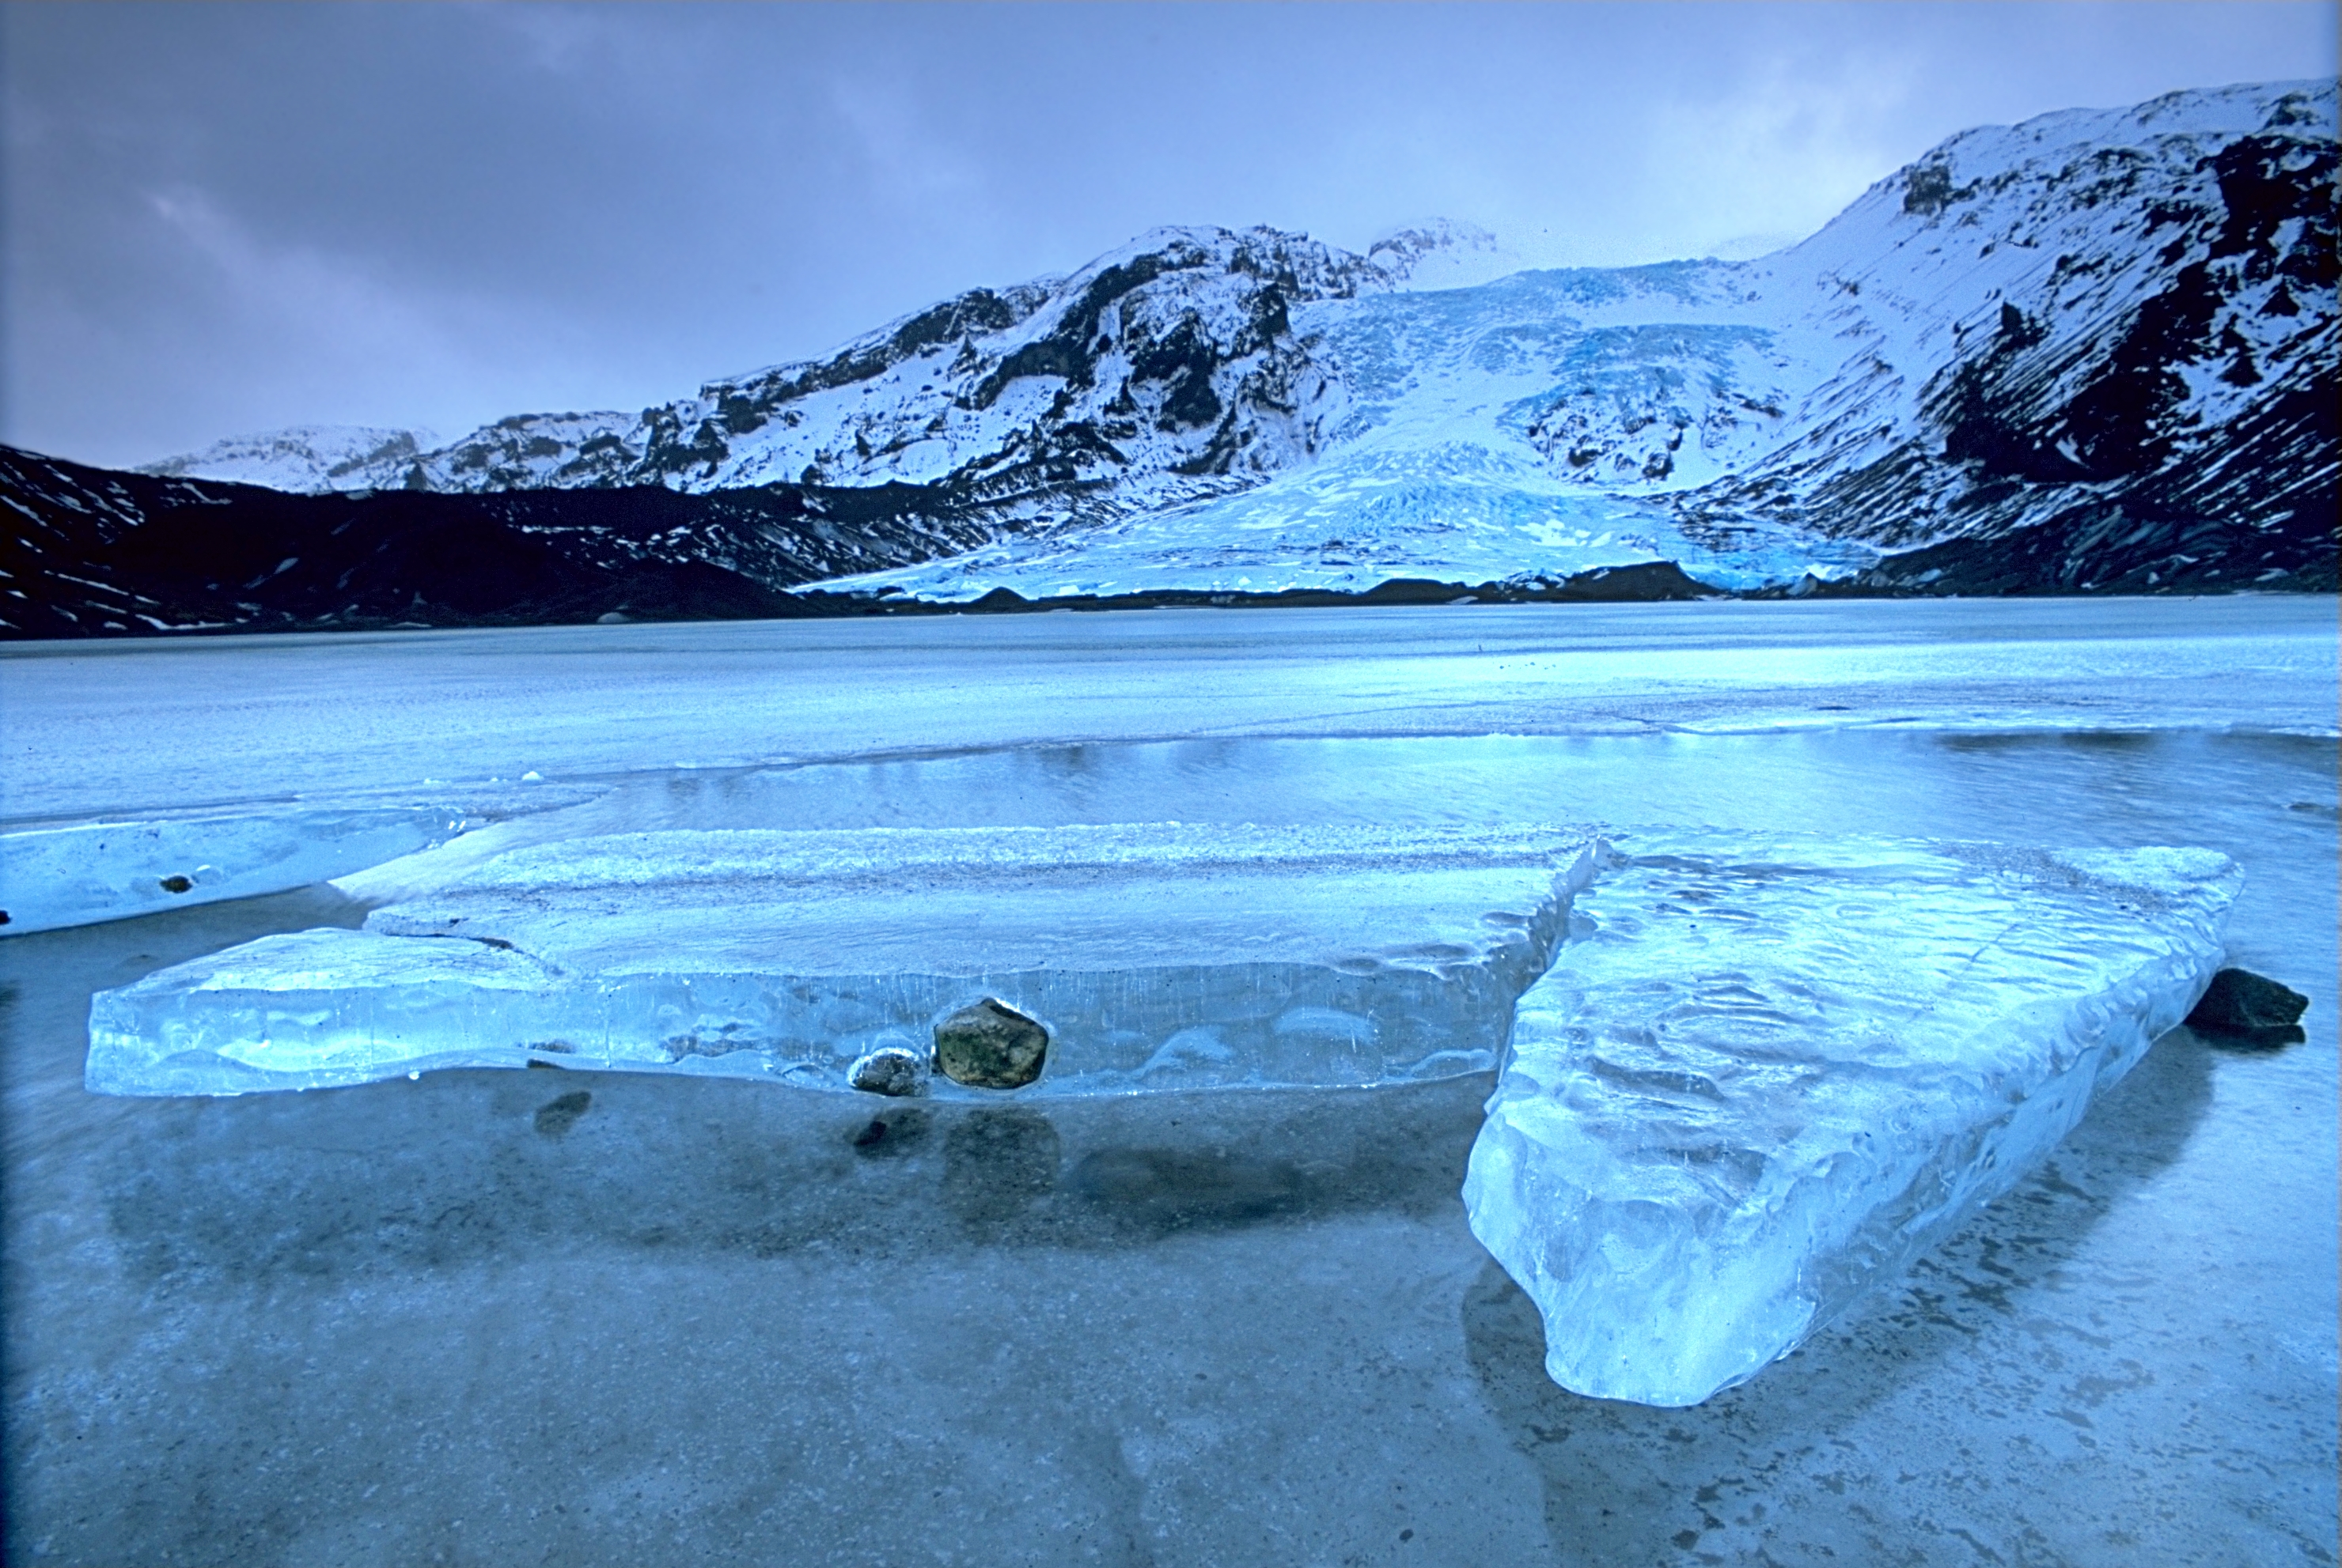
Contact: Drew Gephart
ICELAND
COSTA RICA
Anthropology
Field Studies
Physical
Geography
Gary Hasbrouck
Jayne Smithson
Anthropology
Field Studies
History of Western Art
Jayne Smithson
Maria Guzman
NEW ZEALAND
GERMANY

Slide 9
LSLA Division Update
Valerie Hollins: Her assignment ended in December and due to the classified hiring freeze, she will not be returning this spring.
Suggestion Box: A suggestion box has been installed in D203 to allow anyone to provide comments, suggestions and feedback.

Slide 10
STEAM Division services at Science Annex

Slide 11
IMPORTANT DATES
April 1: Cesar Chavez – Holiday Observance April 2-7: Spring Recess April 26: Last Day to Withdraw from Regular Session Classes with a grade of “W”. All outstanding fees are due even if classes are dropped on this day. April 26: Attendance Verification Day – Instructors Verify Enrollment May 17: Malcolm X’s Birthday – Holiday Observance May 18: Saturday Instruction Ends May 20-24: Final Examinations May 24: Spring Semester Ends
Notes:
Jan 18 (today) . . . . . Discipline Plans: Today IMPORTANT TO ATTEND YOUR DEPARTMENTAL MEETINGS!
Jan 21 (Monday) . . . Martin Luther King Day (Holiday) PERMISSION MUST BE OBTAINED TO ENTER CAMPUS BUILDINGS
Jan 22 (Tuesday) . . . First Day of Classes GET CUSTODIANS AND COLLEAGUES TO HELP YOU GAIN ACCESS TO CLASSROOMS
Jan 26 . . . . . . . . . . . . Last day students can self-enroll THEY HAVE TO GET A PERMISSION NUMBER FROM YOU
Jan 28 . . . . . . . . . . . . Summer and Fall Class Schedules ANOTHER REASON TO ATTEND DEPARTMENTAL MEETINGS
Feb 1 . . . . . . . . . . . . . Annual Program Updates USE THE SHORT VERSION< SEE VPI MILLER’S EMAIL
Feb 3 . . . . . . . . . . . . . Last Day to enroll with Permission Number DEANS WILL SIGN VERY VERY FEW ADD SLIPS AFTER THIS DATE
Feb 3 . . . . . . . . . . . . . Census Rosters due by midnight SUBMIT THEM EARLY TO AVOID LAST MINUTE PANIC
Feb 15-18 . . . . . . . . . President’s Birthday (Holiday) A CHANGE TO BREATHE! NO ONLINE OR WEEKEND CLASSES

Slide 12
TRAVELLING FOLDERS TOPICS
DIRECTIONS:
Break into groups
Pick a scribe to take notes
Everyone’s comments are recorded
Folders are passed when the alarm sounds
Groups share best practices
Notes will be collected at the end
Notes will compiled and shared via email
Late Adds
Promoting courses/programs
Contact hours
Absences
Finals

Slide 13
QUESTIONS?
Thank you!
Notes:
You can use this slide as your opening or closing slide. Should you choose to use it as a closing, make sure you review the main points of your presentation. One creative way to do that is by adding animations to the various graphics on a slide. This slide has 4 different graphics, and, when you view the slideshow, you will see that you can click to reveal the next graphic. Similarly, as you review the main topics in your presentation, you may want each point to show up when you are addressing that topic.
Add animation to images and graphics:
Select your image or graphic.
Click on the Animations tab.
Choose from the options. The animation for this slide is “Split”. The drop-down menu in the Animation section gives even more animations you can use.
If you have multiple graphics or images, you will see a number appear next to it that notes the order of the animations.
Note: You will want to choose the animations carefully. You do not want to make your audience dizzy from your presentation.

