Slide 1
DIVISION MEETING - Liberal Studies and Language Arts (LSLA)
Presented by Dean Lilia Celhay
August 21, 2020

Slide 2
AGENDA
Welcome
Enrollment Management - Lilia
DE Faculty Preparation – AP 4105 - Lilia
Working Remotely - Lilia
Building H - Lilia
Leadership Update - Eva
SLOs: Inclusion in Syllabi for Accreditation - Eva
Student Services Support Online - Ana
Welcome Back Week – Ana
Corona Virus Safety
Important Dates - Ana
Questions?
Notes:
Now, that you have narrowed your topic, you will want to organize your research in a structure that works. There are some common organizational patterns based on the kind of research you are doing.
Organizational Structures:
Cause and Effect- this kind of structure is great for explaining the causes and effects of a topic
Compare and Contrast- in this pattern you highlight the similarities and differences of the topic
Explain process- this structure is great for outlining a series of steps to follow;
Definition- if you want to make sure your audience understands what something is using illustrations, meanings, clarifying misconceptions, you may want to use this structure
Classification- a common organizational structure is grouping like topics or facts from the research together. For instance, in the internet safety about social media apps, you may organize the research where you look at each social media app one at a time

Slide 3
ENROLLMENT MANAGEMENT
90% online except for a few CE courses
Targets for Fall 2020
Spring 2021 Planning

Slide 4
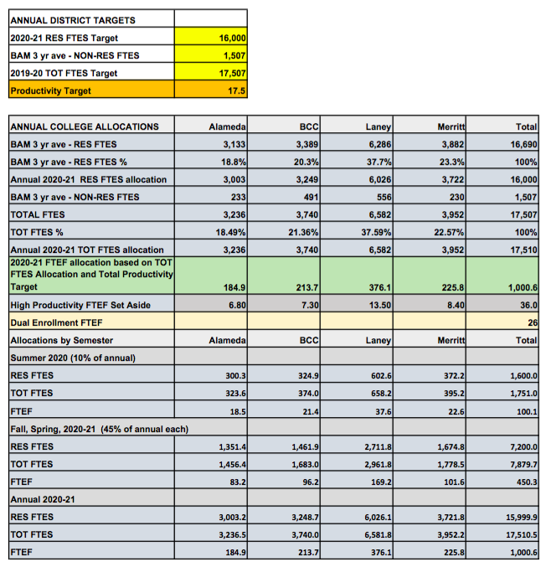
COLLEGE OF ALAMEDA FTEF for 2020-2021: 184.9
For comparison:
2016-2017: 222.6
2017-2018: 224.1
2018-2019: 213.6
Difference from 2019-2020 to 2020-2021= -35.2

Slide 5
Strategies to Reverse Enrollment Trend
Improve enrollment management
College of Alameda
Districtwide
Increase enrollment
Increase retention
Improve completion

Slide 6
DISTANCE EDUCATION FACULTY PREPARATION SURVEY PER AP 4105
LMS TRAINING
Canvas or other
PEDAGOGY TRAINING
USE OF PERALTA EMAIL
This Photo by Unknown author is licensed under CC BY-NC-ND.

Slide 7
WORKING REMOTELY
Websites & Resources
Forms
Adobe Sign
Shared Folders
One Drive
Sharepoint
CANVAS and Zoom

Slide 8
Building H

Slide 9
LEADERSHIP UPDATE
VPI
President

Slide 10
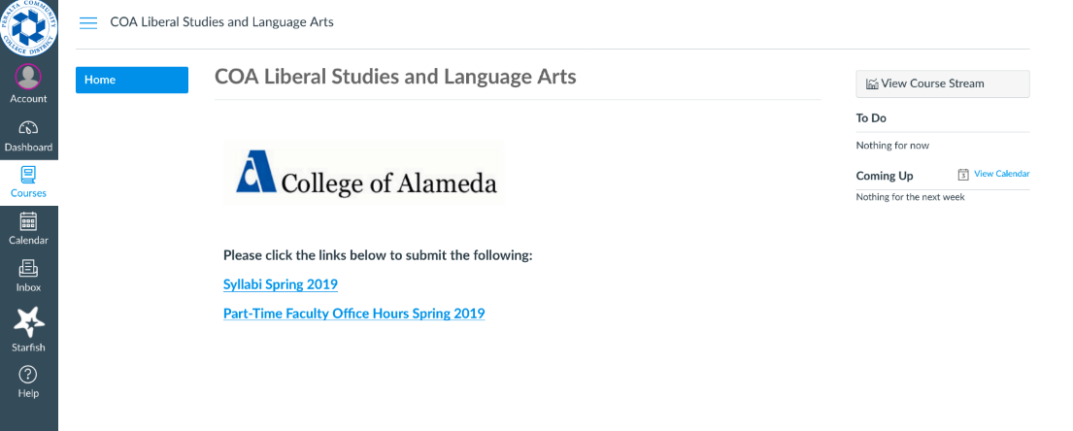
SLOs in Syllabi, Canvas Shells and Accreditation
ACCJC Standard II A. 3
The institution identifies and regularly assesses learning outcomes for courses, programs, certificates and degrees using established institutional procedures. The institution has officially approved current course outlines that include student learning outcomes. In every class section students receive a course syllabus that includes learning outcomes from the institution’s officially approved course outline.
Notes:
Thank you for your patience through the pilot run. We have learned a lot. This practice has saved much time. Future use. . . .

Slide 11
STUDENT SERVICES SUPPORT
Notes:
We are embarking on a new paradigm that focuses on convergence on student completion.
The statewide initiatives are a game changer. As we look at our personal work, we must view it through these statewide initiatives.

Slide 12
CORONA VIRUS SAFETY

Slide 13
Corona Virus Safety Tips
Wipe down shared surfaces regularly with wipes containing 10% bleach or 90% alcohol
Wash your own hands and keep them away from your mouth, nose and eyes (these mucus membranes communicate with each other)
Post handwashing signs in MANY places
Have a scarf you can pull up over your nose and mouth in case you find yourself in “tight” quarters
Stay home if you feel a fever coming on, develop a cough, or have shortness of breath. These are the 3 signs of the Corona Virus.
For more information, please visit Centers for Disease Control and Prevention https://www.cdc.gov/coronavirus/2019-ncov/index.html

Slide 14
IMPORTANT DATES

Slide 15
QUESTIONS?
Thank you!
Notes:
You can use this slide as your opening or closing slide. Should you choose to use it as a closing, make sure you review the main points of your presentation. One creative way to do that is by adding animations to the various graphics on a slide. This slide has 4 different graphics, and, when you view the slideshow, you will see that you can click to reveal the next graphic. Similarly, as you review the main topics in your presentation, you may want each point to show up when you are addressing that topic.
Add animation to images and graphics:
Select your image or graphic.
Click on the Animations tab.
Choose from the options. The animation for this slide is “Split”. The drop-down menu in the Animation section gives even more animations you can use.
If you have multiple graphics or images, you will see a number appear next to it that notes the order of the animations.
Note: You will want to choose the animations carefully. You do not want to make your audience dizzy from your presentation.

