Slide 1

New Faculty Orientation
Tuesday, July 21, 2020
12:30 – 1:30 p.m.
MISSION STATEMENT:
The mission of College of Alameda is to serve the educational needs of its diverse
Community by providing comprehensive an flexible programs and resources that
Empower students to achieve their goals.

Slide 2

AGENDA
Welcome: Hillary Walker (AFRAM), Sarah Odie (POSCI), Calvin Williams – (POSCI), and Hannah Husain (PSYCH)
Access: Email, PeopleSoft (PROMT) and other access
Admissions & Records Topics
  Grading
  Rosters
  Final’s week
Preparing for your class(es)
  Course outline
  Syllabi
  Textbooks
    Follett Bookstore or other online sources
    Open Educational Resources
Conflict in the Classroom
Resources
  Websites
  Your team
Faculty Evaluation & Professional Responsibilities
Professional Development
Questions?

Slide 3
ACCESS
Peralta Portal - MyPeralta
Email
PeopleSoft (PROMT)
CANVAS
APPS

Slide 4
Admission & Records Topics
Rosters: Census and Grade
Grading: A-F, Incomplete, Excused Withdrawal and Pass/No Pass
Academic Calendars
Adding classes
Final’s Week

Slide 5
Office Hours – Article 18
INSTRUCTIONAL LOAD PAID OFFICE HOURS
0-2.99 equated hours 0
3-5.99 equated hours 1
6 or more equated hours 2

Slide 6
Preparing for your Class(es)
Course outline
Syllabi
  Student Learning Outcomes
Textbooks
  Follett Bookstore or other online sources
  Open Educational Resources
Lesson Plans
COA CANVAS and ZOOM Training and Tutorials
Peralta CANVAS Training
Office hours

Slide 7
AP 4105 – Distance Education
B. The instructor must have the following three elements in place prior to being assigned an online course:
1. Has received training in the use of at least one course management system (such as WebCT, Blackboard, ETUDES-NG, MOODLE, Canvas)
2. Has successfully completed a course in how to teach online, such as “Teaching an Online Course” (offered by PCCD/Merritt College, @One, another community college, another appropriate external entity or UC extension course)
3. Uses the Peralta email system (with a peralta.edu email address) and has a Peralta webpage on the college website that hosts the online course. This webpage will provide a link to the CMS/LMS (course/learning management system) website

Slide 8
Conflict in the Classroom
AP 5500
The purpose of this procedure is to provide a prompt and equitable means to address violations of the Student Standards of Conduct, which ensures to the student or students involved the due process rights guaranteed them by state and federal constitutional protections. This procedure will be used in a fair and equitable manner, and not for purposes of retaliation. It is not intended to substitute for criminal or civil proceedings that may be initiated by other agencies.
ADMINISTRATIVE PROCEDURE 5500 STANDARDS OF STUDENT CONDUCT, DISCIPLINE PROCEDURES AND DUE PROCESS

Slide 9
8. Dishonesty: Plagiarism and Cheating
Dishonesty such as cheating, plagiarism (including plagiarism in a student publication), forgery, alteration or misuse of college documents, records, or identification documents, or furnishing false information to the college.
Usual Discipline
A. Written or verbal reprimand. An admonition to the student to cease and desist from conduct determined to violate the Code of Student Conduct. Written reprimands may become part of a student's permanent record at the college. A record of the fact that a verbal reprimand has been given may become part of a student's record at the college for a period of up to one year.

Slide 10
13. Disruptive Behavior
Disruptive or insulting behavior, willful disobedience, habitual profanity or vulgarity; or the open and persistent defiance of the authority of, refusal to comply with directions of, or persistent abuse of, college employees in the performance of their duty on or near the school premises or public sidewalks adjacent to school premises.
Usual Discipline
A. Written or verbal reprimand.
G. Removal from Class. Exclusion of the student by an instructor for the day of the removal and the next class meeting. Instructor must immediately report the removal to the Vice President of Student Services (or designee).

Slide 11
Abbreviated Continuum of Forms of Discipline
Verbal Reprimand
Temporary Removal & Exclusion
Expulsion

Slide 12
Tips
Read AP 5500 and 5530
Document issue(s) via email
  Copy dean as appropriate
Include a reference to AP 5500 in your syllabi
Discuss classroom civility and expectations at the beginning of term
Provide rubrics to help students understand grading
Provide a mechanism for students to understand their standing in the class
Keep grading and attendance records for at least 2 years

Slide 13
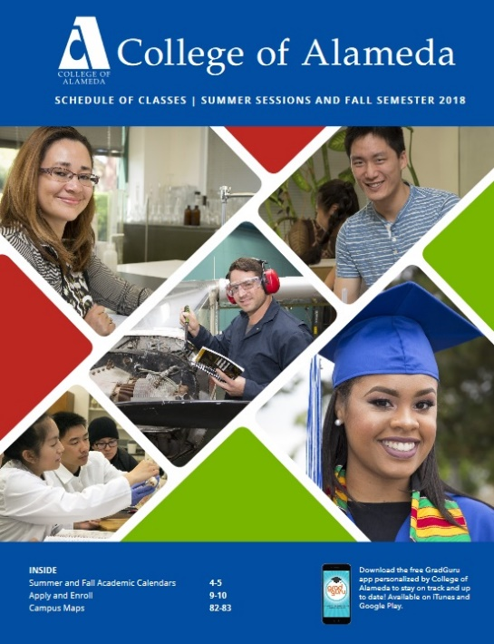
Resources
Websites
  Peralta
  College of Alameda
  Peralta Federation of Teachers (PFT)
Publications: Catalog and class schedule
Your team
  Department Chairs: Sarah Peterson and Ed Loretto
  Lead Faculty: Jody Campbell and Robert Brem
  Lilia Celhay, Dean
  Brenda Lewis, Staff Assistant
Notes:
Discipline Plan: Assures every semester contributes to the pathway for completing a degree or certificate
Block Schedule
Conferring regarding Assignments
Facilities needs and wants
Special considerations

Slide 14

Faculty Evaluation and Professional Responsibilities
FACULTY EVALUATION
Part-time faculty are evaluated during their first year and then every three years
PROFESSIONAL RESPONSIBILITES
Professional development
Grading
Submission of rosters
Submission of book orders
Meets clock hours
Responsive to communication
Displays behavior consistent with professional ethics and academic freedom

Slide 15
Professional Development
Conferences
Workshops and other trainings
Classes
Part-time faculty are eligible for $900 reimbursement
COA Professional Development Committee: PD Funding and other Information
Notes:
Full time faculty load in the Peralta system is 15 hours contact hours per week

Slide 16
Tips and Other Information
Eligible classes can be used for salary advancement
Apply to full-time positions
Look for educator discounts
Get involved in shared governance committees
Connect with colleagues

Slide 17
QUESTIONS?
THANK YOU!!!!

