Slide 1
Library Resources for PSYCH 28
Librarian: Adam Mann
Email: amann@peralta.edu
Notes:
Greeting / overview (5 minutes)
- Talk about the research desk, what the library is here for, etc
- Getting to the library website, asking for help

Slide 2
After this class you will...
Understand the basics of finding sources appropriate for research and getting help
Understand how to develop and narrow down a research question
Know how to use the library to locate articles
Be able to cite sources using the APA citation style

Slide 3
COVID-19 – What's Different In the Library?
Contacting library staff
- Use the COA Library Chat!
Need books from the library?
Circulating books can be picked up curbside. Most reserve books are not being checked out, but you can ask the library staff about exceptions.
Accessing books online?
Also: Wi-fi is available in the parking lot of C/D buildings; books will not be overdue until the library reopens

Slide 4
ARTICLE DATABASES
For an expert opinion

Slide 5
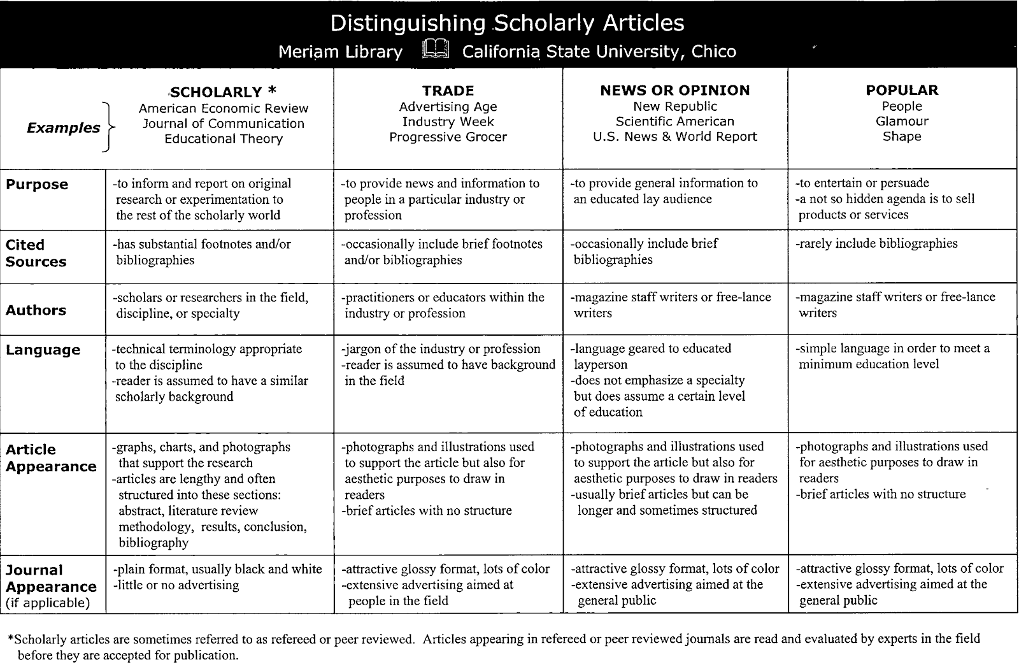
What makes a Scholarly Article?

Slide 6
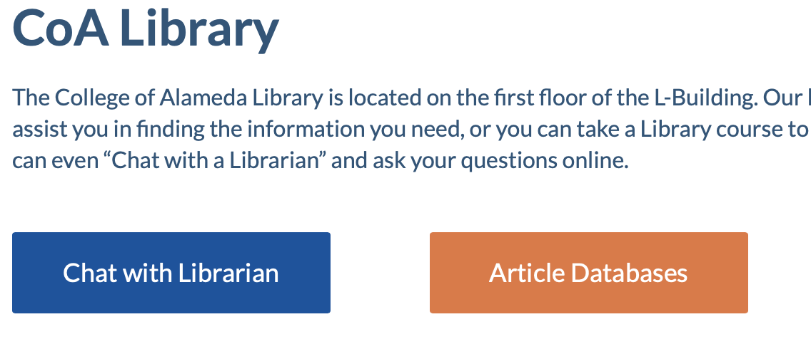
Example Images
Notes:
Show them how to use library databases to find scholarly articles (10 minutes)
- Show them generally how to get into library databases. Talk about library databases. Show academic search complete. Do a sample search to show them what's possible

Slide 7
Sample Research Question
What effect does genetically engineered food have on the health of consumers?

Slide 8
Main Ideas
What effect does genetically engineered food have on the health of consumers?
The main ideas are:
Genetically engineered food
Health
Consumers

Slide 9
Choosing and Narrowing a Topic
State your topic as a question
- What effect does genetically engineered food have on the health of consumers?
Identify the main concepts
- Genetically engineered food AND health AND consumers
3. Select alternative keywords for main concept
Main Concepts | Alternative Terms
genetically altered foods | GMO biotechnology and food genetically engineered
health and safety | food safety hazard(ous) bell being
consumers | public people

Slide 10
Example Images

Slide 11
What is empirical research?
"Empirical research is based on observed and measured phenomena and derives knowledge from actual experience." - Penn. State University Libraries
Primary sources – the author or authors are the ones collecting the data. Empirical sources are primary research.
Secondary sources – the author or authors are writing about data someone else has collected.

Slide 12
How can you spot an empirical research article?
Such articles typically have 4 components:
Introduction: sometimes called "literature review" -- what is currently known about the topic
Methodology: sometimes called "research design" -- how to recreate the study
Results: sometimes called "findings" -- what was learned through the study
Discussion: sometimes called "conclusion" or "implications" -- why the study is important

Slide 13
CITING SOURCES
Can’t I just give you a link?
Notes:
APA format (10 minutes)
- Talk about the two parts of APA: in-text citations and the Works Cited page
- Talk about why citations, plagiarism, etc
- Show them tools for crafting citations (citation machine)
- Let them know tools for generating citations in databases
- Have them make some citations

Slide 14
What is the purpose of a citation?
Showing that an idea came from somewhere else
Helping the reader trace an idea back to its original source
Uses a predefined style that’s easy to read
Citing work helps to avoid being accused of plagiarism

Slide 15
When do you cite?
When you use information that you got from somewhere else
When paraphrasing, summarizing, or giving results of a study
When directly quoting from a source
…when in doubt, cite!

Slide 16
APA In-text citation example:
APA References page citation:
Less than one percent of rental units in the Bay area are designated low income (Murphy, 2019, para. 5).
Murphy, R. (2019, August 7.) Where can you afford to rent in California? Los Angeles Times. www.latimes.com/calculator.

Slide 17
Newspaper citations in Citation Machine (citationmachine.net)
Vital info: contributor, date of publication title of piece, name of the website, and the URL are the most important pieces of information
Your citation should look something like this:
Murphy, R. (2019, August 7.) Where can you afford to rent in California? Los Angeles Times. www.latimes.com/calculator.

Slide 18
Thanks!
Any questions?
Adam Mann
You can find me at:
amann@peralta.edu

