Slide 1
President’s Flex Day presentation Dr. Nathaniel Jones III Jan. 22, 2021

Slide 2
Topics Jan. 22, 2021
- Welcome & Remarks
- Accreditation Updates
- Budget & Admin. Updates
- Priorities & Objectives
- Academic & Student Affairs Highlights

Slide 3
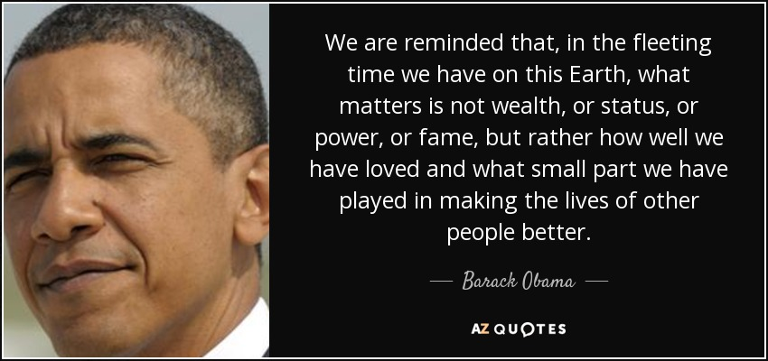
Welcome & Remarks

Slide 4
Leadership axioms
Emphasize outstanding performance, efficiency, and value-added quality in services, processes and systems
Innovation and continuous improvement are vital to thriving in the challenging and changing higher education environment
Community is enhanced when its members collaborate, are empathetic, respectful, and compassionate.

Slide 5
Reflections ON call to action
Empathy
Empowerment
Equity

Slide 6
Accreditation update
Special ACCJC Report
Institutional Self Evaluation Report (ISER)

Slide 7
ACADEMIC YEAR 20/21 RESPONSE PLAN
Campus Community Safety
Online Instruction
Virtual Student Services
Student Access & Equity
CARES Act Funding Allocation
Facilities & Campus Operations

Slide 8
Academic & Student Affairs Highlights
Instruction
New Ethnic Studies & LGBTQIA+ courses & Programs
Increased enrollment through new curriculum (CNA)
Faculty Professional Development in Effective Online Instruction
Support for Students in essential workers academic programs

Slide 9
Academic & Student Affairs Highlights
Student Services
Food distribution to support students
Computer distribution
CoA Cares Communication campaign
Online student counseling and other support services
CoA Cares Call Center

Slide 10
Academic & Student Affairs Highlights
Campus-wide Efforts
Guided Pathways
Institutional Effectiveness Partnership Initiative (IEPI)
Strategic Enrollment Management (SEM)
Website Redesign

Slide 11
FY21 Budget & Admin UPDATE

Slide 12
FY2019-20 General Fund 01 Budget Review
Notes:
Overspent $1.01M FY 18-19, -6%

Slide 13
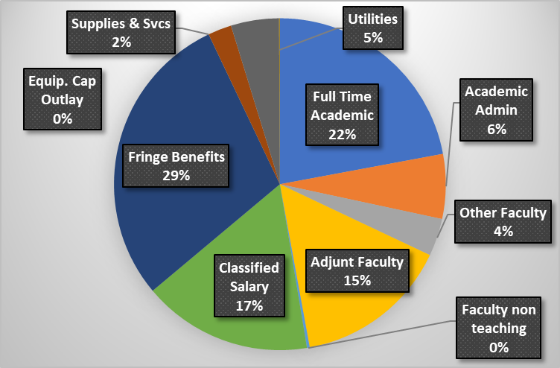
FY 19-20 Fund 01 Actual Expenditures

Slide 14
AY19-20 Enrollment Summary
Terms | Targets | Actual FTES Production | Variance
Summer | 327 | 338 | 11
Fall | 1,471 | 1,323 | -148
Spring | 1,471 | 1,219 | -252
Total | 3,269 | 2,880 | -389

Slide 15
FY 20-21 Budget

Slide 16
AY20-21 Enrollment Summary
Terms | Target | Actual FTES Production | Variance
Summer | 300 | 292 | -8
Fall | 1,351 | 1,154 | -197
Spring | 1,351 | 1,097 | -254
Total | 3,002 | 2,543 | -459

Slide 17
 | Spring 21 | Spring 20 | percent change to prior year
Census Enrollment | 7,590 | 11,102 | -32%
Unduplicated Headcount | 4,823 | 6,089 | -21%
FTES | 957 | 1,468 | -35%
FTEF | 84 | 100 | -16%
Notes:
Census enrollment, unduplicated headcount, FTES and FTEF as of Jan 21. Census is down by 32% compared to last year. FTES is down by 35% and FTEF is down by 16%. Our unduplicated headcount is down by 21% with many students opting to enroll with our sister colleges.
Of students who have identified College of Alameda as their home college or have earned more than 12 units at College of Alameda, 740 students are enrolled in over 1450 courses at either Laney College, Berkeley City College, and Merritt College in Spring 2021.

Slide 18
Top Courses for
COA swirling students
Notes:
For COA students who are swirling this semester, these are the top courses our students are enrolling in by College.

Slide 19
FISCAL Stewardship ACTIONS & STRATEGIES
Increase revenues from extramural sources
Increase enrollments and student success as measured by SCFF metrics
Boldly pursue operational efficiencies
Limit hiring to strategically vital positions
Enhance budget alignment with institutional priorities and strategic objectives

Slide 20
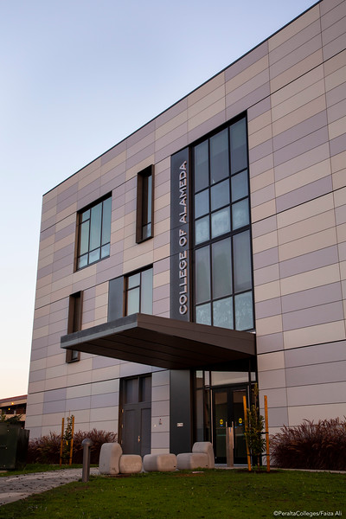
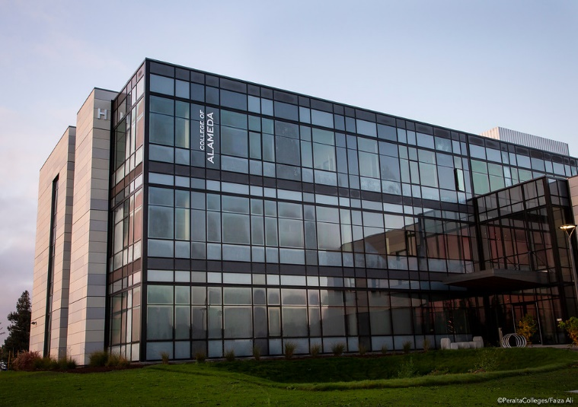
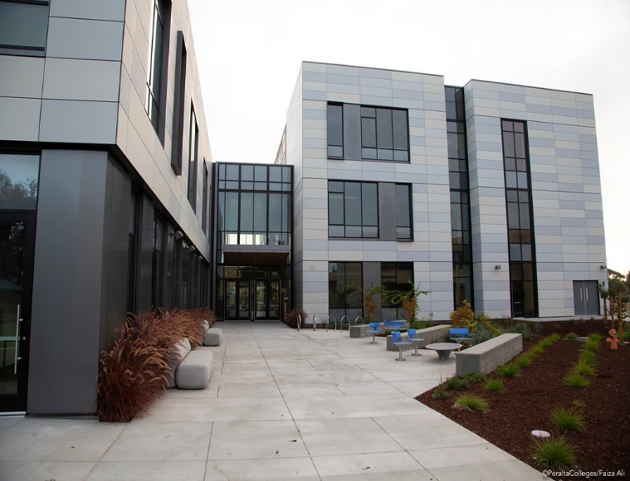
FY 2020-21 Administrative Update
New Center for Liberal Arts Building is move in ready
For more building information
https://build.peralta.edu/new-center-for-liberal-arts
https://peraltacolleges.smugmug.com/COLLEGE-OF-ALAMEDA/COA-BUILDINGS/Center-for-Liberal-Arts-Building/

Slide 21
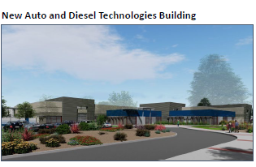
FY 2020-21 Administrative Update
Meetings with departments
Currently in the design phase

Slide 22
FY 2020-21 Administrative Update
Campus wide parking lot/ curbside repaint
Parking lot new signages
New Gym bleacher (manufacture in production, installation Est. in March)
Other campus projects
Update of the Facilities Master Plan

Slide 23
DISTRCT & COLLEGE PLANNING
Plan
Assess
Analyze
Improve

Slide 24
Strategic institutional priorities/Themes
Strategic Master Plan
Education Master Plan
Increase Access to Programs & Courses
Increase Student Persistence and Retention Rates
Increase and Enhance Community, Business & Educational Partnerships
Advance Teaching & Learning
Strengthen Data-driven Decision Making
Establish Integrated Planning & Assessment System
Advance Student Access, Equity & Success
Engage and Leverage Partnerships
Build Programs of Distinction
Strengthen Accountability, Innovation and Collaboration
Develop and Manage Resources to Advance Our Mission

Slide 25
Strategic institutional priorities/Themes
Academic Excellence
Student Access & Success
Diversity, Equity & Inclusion
Fiscal Stewardship & Accountability
Community Engagement & Strategic Partnering
Institutional Effectiveness

Slide 26
Questions & Answers

Slide 27
Meet the moment, but remain true to our values THANK You!

